Slide 1

Postdoctoral Policy & Web Forms Training for Administrators
Mar 2025

Slide 2
Training Sections
General Appointment and Policy Information
  Postdoctoral Scholar: Definition and Acronyms
  Postdoctoral Administrators: Responsibilities & Resources
  Postdoc Web Forms: Roles, Training and Authority, Confidentiality
  The Postdoctoral Appointment: Criteria, Processing Timelines, SUNet ID Sponsorship
  The Postdoctoral Appointment: Sponsorship, Budgeting, Eligibility
New Postdoctoral Appointment (Invite and Recommendation Forms)
  Admin: Process Overview, Initiate Invite Form
  Candidate: View of Invite and Data Form
  Admin: Data Form Review
  Admin Entry: Create a Recommendation Form
  Candidate: View of Offer Letter
  Admin: Submit a Recommendation Form
  Visas for International Scholars
New Postdoctoral Appointment, continued
  Salary and Stipend
  Postdoc Benefits
  Individual Development Plan
  Change Form
  Termination Form
    Early Termination by Faculty Sponsor
  Unpaid Leaves of Absence

Slide 3
Postdoctoral Scholars
Definition and Common Acronyms

Slide 4
What is a Postdoctoral Scholar?
Definition from Research Policy Handbook, Chapter 10.3
  “A Stanford POSTDOCTORAL SCHOLAR is a non-matriculated trainee, in graduate student status, in residence at Stanford University pursuing advanced studies beyond the doctoral level in preparation for an independent career. Postdoctoral Scholars are appointed for a limited period of time and may participate on Stanford research projects and/or may be supported by external awards or fellowships. In all cases, their appointment at Stanford is for the purpose of advanced studies, research, and training under the mentorship of a Stanford faculty member.”
A researcher at Stanford who has received a doctoral degree:
  PhD, MD, PhD/MD, DVM, PsyD, JD
A non-matriculated, non-degree seeking student
Is NOT in graduate student, postdoc, or employment status with another institution, anywhere else
The Postdoc Administrator is responsible for knowing postdoctoral eligibility before starting a postdoctoral appointment
https://postdocs.stanford.edu/policy

Slide 5
Common Postdoc Acronyms
OPA: Office of Postdoctoral Affairs
Postdoc: Postdoctoral Scholar, Postdoctoral Fellow, Research Scholar (used interchangeably)
VSR: Visiting Student Researcher (NOT yet a Postdoc; appointed by Registrar’s Office)
GFS: Graduate Financial Support (system used to pay Postdocs)
J-1: J-1 Scholar Exchange Visitor Visa (expected visa status for international scholars)
  DS-2019: Stanford-issued document; Postdoc takes to US embassy to get J-1 visa
OPT: Optional Practical Training (training period for postdocs on F-1 visa)
  EAD: Employment Authorization Document (EAD card for F1 OPT, also J-2, H-4, LPR advance parole)
H-1B: Employment Visa (requires policy exception approval)
RPH: Research Policy Handbook (university policy resource)
GME: Graduate Medical Education office (School of Medicine only)

Slide 6
Postdoctoral Administrators
Responsibilities and Resources

Slide 7
Postdoc Admin:
Responsibilities
Primary resource for policy guidance and implementation to faculty and postdocs in your department:
  Initiate appointments, monitor extensions, monitor funding, and initiate terminations
  Orient new postdocs to Stanford and department/lab:
    Pre-arrival communication, arrival meeting, onboarding, and ongoing resource
  Enroll postdoc in mandatory Postdoc Benefits Orientation
  Identify training requirements for postdocs, monitor compliance
  Ensure postdocs have current appointments (future end date) and are correctly funded
  Advise faculty on all policy-related matters (appointment term limits, visa restrictions, etc.)
  Prepare necessary web forms and documentation for OPA review and approval
  Maintain complete and accurate postdoc records
  Attend Quarterly Postdoctoral Administrator meetings
  Advocate for network building opportunities
    Include postdocs in department functions, email lists, academic and social activities where they feel part of the unit/lab
https://postdocs.stanford.edu/postdoctoral-administrators/new-administrators/administrator-responsibilities

Slide 8
Postdoc Admin:
OPA Resources
OPA’s Website Contains:
  All Policy and Procedural Information
  Postdoc Admin Home Page
  PD Web Forms Training Slides and Job Aids
  Postdoctoral Benefits Information
  Postdoc Administrator Blog
    Searchable archive of historical policy memos and quarterly meeting presentation slides
http://postdocs.stanford.edu

Slide 9
Postdoc Admin:
OPA Resources
OPA Managers, by School
  School of Medicine
    Alistair Murray Kanza Naqvi
    alistair@stanford.edu and kanza@stanford.edu
    (650) 498-7618
  All other Schools and Dean of Research groups/Independent Labs
    Tammy Wilson
    tjwilson@stanford.edu
    (650) 380-1283
    https://postdocs.stanford.edu/about/staff

Slide 10
Postdoc Admin:
OPA Resources
Department/Lab Orientation
  Prepare a packet for New Postdocs
Create an onboarding checklist:
  https://postdocs.stanford.edu/postdoctoral-administrators/orientation-toolkit-administrators
“Getting Started at Stanford” for Postdocs:
  https://postdocs.stanford.edu/onboardingchecklist
Find the answers: People and Offices to Support You:
  https://postdocs.stanford.edu/current-postdocs/people-and-offices-support-you

Slide 11
Postdoc Admin:
OPA Resources
Postdoc Administrator’s Mentoring Group
  Expert Postdoc Administrators who volunteered to be available to other Postdoc Administrators to answer policy and process questions and to inspire interdepartmental collaboration among all Postdoc Administrators
  Other Admins are a great resource for sharing information on department-level processes, reports, templates, etc.
  Submit a Service Now Help Ticket to be connected to a Postdoc Admin Mentor
  https://postdocs.stanford.edu/postdoctoral-administrators/mentoring-group-postdoctoral-administrators

Slide 12
Postdoc Admin:
GFS Resources
Personalized help with GFS:
  Service Now Help Ticket to GFS
  GFS Help Page
  GFS How To… Job Aids
  PeopleSoft Training Center

Slide 13
The Postdoctoral Appointment
Criteria, Processing Timelines, SUNet ID Sponsorship

Slide 14
Policy:
Appointment Criteria
Registration fee: $125 per quarter, paid by Dean (SOM) or Provost (University)
Start date: Within 3 years of PhD conferral or 6 years of MD conferral
FTE basis: Full time, 100% FTE required
Minimum term: 9 months for new appointments
Maximum term: 60 months (5 years) combined (all institutions) TOTAL term limit
Extensions: In increments of days, weeks, months, years (up to 60 month term limit)
6th Training Year: Policy exception approval required for 6 years combined TOTAL term limit
Funding level: Minimum funding amount required, no maximum funding limit
Funding source: Allowable department funds, research grants, training grants, or external fellowships, in any suitable combination of sources; postdocs cannot be self-supporting
Benefits: Medical, dental, vision, disability, and leave benefits
Unpaid Leave: 90 day maximum leave period
Start date: Up to 30 days retroactive for good cause (with proof of degree and valid work status)
  https://postdocs.stanford.edu/policy

Slide 15
Process:
Appointment Processing Timelines
Appointments must be submitted to OPA with ALL required supporting documents early enough to allow for adequate processing time at OPA, and at Bechtel International Center (for international scholars)
  US Citizens, Permanent Residents, F1 OPT with EAD card:
      5-7 business days prior to the requested appointment start date
  J-1 Scholars:
      2-3 months prior to the requested appointment/visa start dates
  H-1B Visas Holders:
      3-6 months with premium processing; requires premium processing fee
Recommendation forms with insufficient proof of doctoral degree or other missing items will delay these timelines
https://postdocs.stanford.edu/postdoctoral-administrators/appoint-postdoctoral-scholars

Slide 16
Process:
SUNet ID Sponsorship
A SUNet ID and a Stanford email address are included with the postdoc appointment
  OPA creates the Student ID (Empl ID) number after the appointment is approved
  The postdoc uses the Student ID to create a SUNet ID
In some cases, the department may wish to sponsor a SUNet ID before appointment approval
  Please ensure proper procedures are followed to avoid creation of a duplicate Empl ID
    Conduct a SEARCH/MATCH in Axess to determine if there is an existing Student ID
    If Admin does not have access to SEARCH/MATCH, contact OPA to do the search
Note the existing or newly created Student ID in the “Notes to Approver” text box on the Recommendation form to notify OPA so we don’t create a duplicate ID

Slide 17
The Postdoctoral Appointment
Sponsorship, Budgeting, Determining Candidate Eligibility!

Slide 18
New Appointment:
Process Overview
Eligible Faculty Sponsor/PI identifies a Postdoc candidate
Postdoc Admin (Role #1) confirms faculty eligibility, budget, candidate eligibility; initiates Invite
Postdoc candidate completes online Data form (Info sheet) and uploads supporting documents
Postdoc Admin (Role #1) reviews and approves the Data form
Postdoc Admin (Role #1 Entry) creates and submits a Recommendation form
Department Manager/DFA (Role #3) approves the Recommendation form
    Generates the online Offer Letter to the Postdoc candidate
Postdoc candidate reviews and accepts the online Offer Letter
Postdoc Admin (Role #1 Verify) verifies the appointment terms and approves the Recommendation form to OPA for review
OPA reviews the Recommendation form for appointment approval
https://postdocs.stanford.edu/postdoctoral-administrators/appoint-postdoctoral-scholars

Slide 19
Policy:
Who Can Sponsor a Postdoctoral Appointment?
Faculty Sponsors Must be Members of the Professoriate
Tenure Line Faculty (UTL)
  Assistant Professor
  Associate Professor
  Professor
Non-Tenure Line Faculty (NTL-)
  Assistant Professor (Research)
  Associate Professor (Performance, Teaching, Research)
  Professor (Applied Research, Clinical, Performance, Teaching, Research)
Medical Center Line Faculty (MCL)
  Assistant Professor
  Associate Professor
  Professor
Other Faculty Designations
  Assistant Professor (Subject to PhD)
  Senior Fellow at designated policy centers and institutes (defined in Section 2.3.2)
  Center Fellow at designated policy centers and institutes (defined in Section 2.3.2)

Slide 20
Policy:
Who Can Sponsor a Postdoctoral Appointment?
These Affiliations Cannot Sponsor a Postdoc
  Clinician/Educators (C/E) line appointed as:
    Clinical Instructor
      Unless granted a policy exception by the Office of the Senior Associate Dean of Research (Ruth O’Hara)
  Courtesy Professorships
  Adjunct Professorships
  Senior Staff Scientist
  Staff Scientist
  Instructors

Slide 21
Process:
Budgeting for a Postdoctoral Appointment
What is the Department’s annual COST TO SPONSOR a Postdoc?
Coverage | Annual insurance* (paid in monthly installments) | Minimum Annual Salary** (0Yr 0Mo research experience) | Minimum Required Total Funding
Postdoc Only | $12,350 + | $73,800 + | $86,150 +
PD + Spouse | $24,863 + | $73,800 + | $98,663 +
PD + Children | $20,125 + | $73,800 + | $93,925 +
PD + Family | $34,553 + | $73,800 + | $108,353 +
Annual Funding Minimum
  $73,800 as of 09/01/24 (0Yr 0Mo research experience)
    More research experience = higher annual funding minimum
  Department or faculty may set a higher funding amount
Benefits Expense see table --->
Other Cost Considerations (not included in table):
  Fringe Rates and/or Indirect Costs
    Work with your department’s grants manager to determine if fellowship will incur these costs
  Research & Lab Costs, Conference & Presentation Expenses
    As needed or anticipated
  https://postdocs.stanford.edu/budgeting-postdoctoral-fellowship
* Rates will likely increase Calendar Year 2026 effective January 1, 2026. Estimate a 5% increase for months Jan 2026‐on.
** Minimum will increase for Academic Year 2025‐26 effective September 1, 2025. Estimate a 3-4% increase for months Sep 2025‐on.

Slide 22
Process:
Determine Eligibility
  Confirm the Following:
    Appointing faculty is eligible to sponsor a postdoc
    Adequate budget/funding exists to support the appointment
    The candidate is eligible to be appointed as a postdoc
      Pre-determined eligibility avoids time wasted preparing web forms for ineligible candidates
  Obtain These Documents From the Candidate:
    Proof of doctoral degree
    Current CV with dates in mm/yyyy-mm/yyyy format
      (yyyy-yyyy format is insufficient for previous research experience calculation)
    Outside funding letter(s), if any
    https://postdocs.stanford.edu/postdoctoral-administrators/appoint-postdoctoral-scholars

Slide 23
Policy:
Determine Eligibility
Eligibility Criterion 1 – Completion of All Doctoral Degree Requirements
  Has the candidate completed all degree requirements as evidenced by diploma, degree certificate, or letter of completion issued by a Registrar or central office?
    (PhD within the last 3 years; MD within the last 6 years)
Review the Proof of Degree document
    If Yes, continue the eligibility review
    If No, degree requirements are not complete, the candidate is NOT eligible for a postdoc appointment
      Consider a Visiting Student Researcher appointment with University Registrar's Office, OR
      Delay postdoc appointment start date until all degree requirements are met

Slide 24
Policy:
What is Accepted as Proof of Degree?
Proof of Doctoral Degree – Accepted Documents
  Copy of doctoral diploma or degree certificate:
    English translation required if issued in a foreign language
  In the absence of a diploma or degree certificate, a Letter of Completion is acceptable IF:
    Issued by a Registrar or equivalent central office (Graduate Studies, Dean, etc.)
    Confirms ALL degree requirements are met, including submission, acceptance, and defense of thesis; and the expected date of degree conferral
  Transcript: Must note degree earned and conferral date (unofficial copy ok)
Stanford PhD graduates must upload proof of degree
  https://postdocs.stanford.edu/postdoctoral-administrators/appoint-postdoctoral-scholars

Slide 25
Policy:
What is not Accepted as Proof of Degree?
Proof of Doctoral Degree – Unacceptable Documents
  Letter from the PhD Advisor or academic department
  Central office-issued letter that confirms all coursework is complete but does not confirm all degree requirements are met (e.g., notes a future date of submission, acceptance, or defense of thesis)
Conditional DS-2019 Policy Exception
  To facilitate visa processing, international scholars can provide a letter noting an upcoming defense date that may justify a review for a conditional DS-2019 approval prior to the appointment approval
    Check the appropriate policy exception box on the recommendation form
    Upload a PDF copy of the letter of progress toward degree

Slide 26
Policy:
Determine Eligibility
Eligibility Criterion 1 – Completion of All Doctoral Degree Requirements
  If the doctoral degree was conferred more than 3 years ago (PhD) or more than 6 years ago (MD), approval of an appointment requires:
      An approved policy exception request
        Select the policy exception checkbox on recommendation form and enter responses in the supporting statement text boxes
      Less than 52 months of previous research experience
        See slide for Eligibility Criterion 3

Slide 27
Policy:
Determine Eligibility
Eligibility Criterion 2 – Appointment or Employment Elsewhere
  Will the candidate be appointed at another institution or employed elsewhere concurrently with the Stanford postdoctoral appointment?
  Review the CV for current appointment or employment elsewhere
    Confirm any current appointment or employment will end before Stanford start date
  Carefully review outside funding letters and award contracts for language that specifically states or implies an affiliation or employment elsewhere
    i.e., funding called “salary”; mention of tax withholdings, etc.
      If No, continue the eligibility review
      If Yes, the candidate is NOT eligible for a postdoc appointment
        Consider a Visiting Postdoc or Visiting Scholar appointment with Faculty Affairs

Slide 28
Policy:
Determine Eligibility
Eligibility Criterion 3 – Prior Research Experience
  Does the candidate have any prior postdoctoral research experience?
Review the CV for previous appointments or employment that include postdoctoral research
    If No, the candidate IS eligible for a postdoctoral appointment
    If Yes, estimate the number of months of prior research experience
      1 to 51 months: the candidate IS eligible for a postdoctoral appointment
        Within postdoctoral policy term limits
      52+ months: the candidate is NOT eligible for a postdoctoral appointment
        Consider a Visiting Scholar appointment with Faculty Affairs, OR
        Consider an Academic Staff-Research (AS-R) or Consultant appointment with Human Resources
    https://postdocs.stanford.edu/postdoctoral-administrators/how-quick-links/calculate-months-experience-research-non-clinical

Slide 29
Apply Your Knowledge:
Sponsorship, Budget, & Eligibility
Real World Training Scenario:
  You are a new Postdoc Admin for PI David Lobell, a Professor of Earth System Science, at the Freeman-Spogli Institute – Center on Food Security and the Environment
  Prof Lobell asked you to appoint a new postdoc starting fall quarter
  Before sending the appointment invite, you confirm these things:
    Prof Lobell is a member of the professoriate eligible to sponsor a postdoc
    Prof Lobell confirmed he has sufficient funding for salary, benefits, and extras
    Postdoc candidate is eligible to be appointed as a postdoc at Stanford
  You obtain the candidate’s contact information and the appointment terms from Prof Lobell

Slide 30
Process:
Information Needed to Initiate Appointment
Postdoc candidate’s first and last names
Postdoc candidate’s email address
  Email address must be valid until the appointment is approved
  DO NOT use an email address previously used for a postdoc invite
    (department transfers or returning Stanford postdocs)
Appointment start and end dates
Annual funding amount and source
Any other terms offered or required by the sponsoring PI or department
  (e.g., moving expense reimbursement, teaching requirements, etc.)
  Follow your department’s internal practices and policies

Slide 31
Apply Your Knowledge:
Gather Information Needed
Real World Training Scenario:
  Professor Lobell provides the following information to you:
    Candidate’s first and last name: Robin Hood
    Candidate’s email address: newpostdoctest.robinhood7490@outlook.com
    Appointment start and end date: 09/01/2024 – 08/31/2025
    Annual funding: Calculate based on research experience
    Funding source: Prof Lobell’s research grant
    Additional appointment terms:
      Up to $2,500 reimbursement for moving expenses
      Postdoc is required to teach a one quarter undergraduate class
  You email Robin, introduce yourself, and ask him to send you PDF copies of his doctoral degree and current CV
    Robin will be fully supported by Prof Lobell and has no outside funding

Slide 32
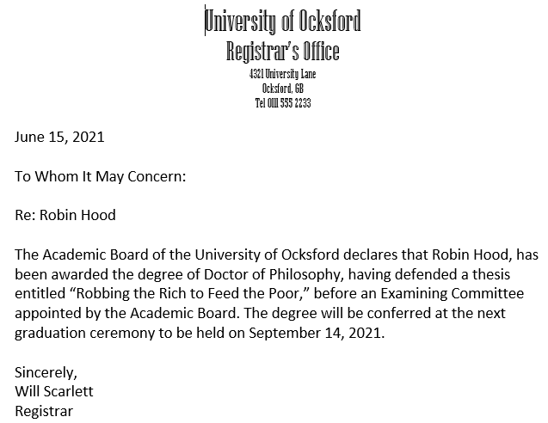
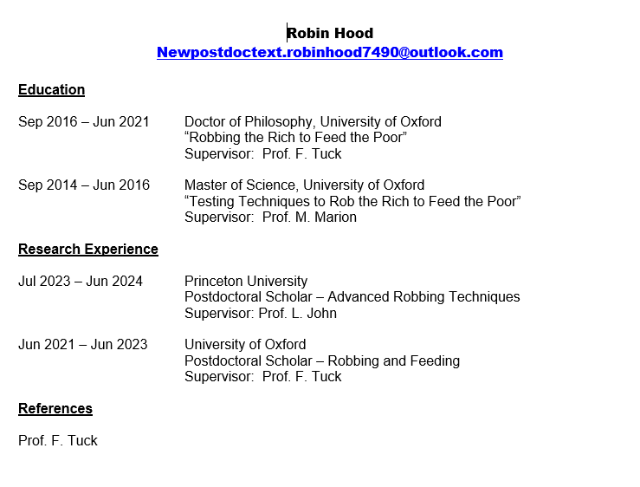



Apply Your Knowledge:
Eligibility
Robin’s Letter of Completion
Robin’s Current CV

Slide 33
Apply Your Knowledge:
Eligibility
Real World Training Scenario:
Eligibility Criterion 1 – Completion of All Degree Requirements
  Review Robin’s letter of completion Robin’s letter of completion
    Has Robin completed all doctoral degree requirements?
      Yes; continue the eligibility review
    Was Robin’s PhD degree conferred within the last 3 years?
      No, the degree was conferred more than 3 years ago; will require a policy exception request
      Continue the eligibility review
Eligibility Criterion 2 – Appointment or Employment Elsewhere
  Review Robin’s CV
    Does Robin have a current appointment or employment elsewhere?
      No, the CV shows past end dates for all previous research experience
      Continue the eligibility review

Slide 34
Apply Your Knowledge:
Eligibility
Real World Training Scenario:
Eligibility Criterion 3 – Prior Research Experience
  Review Robin’s CV
    Does Robin have any prior postdoctoral research experience?
      Yes, estimate the number of months of research experience = 36 months
        See the next slide for detailed research calculation estimation
        Is the research experience within policy limits (less than 52 months)?
          Yes, continue to the appointment invite

Slide 35
Apply Your Knowledge:
Eligibility
Real World Training Scenario:
Robin’s CV shows:
36 months (12+24) prior research experience
Postdoc policy permits discount of the first 12 months of research experience in the PhD lab with PhD advisor
After discount, Robin has 24 months of prior research experience, and is eligible for a postdoc appointment up to 36 months at Stanford
Next steps:
  Initiate a new appointment Invite form
    https://postdocs.stanford.edu/postdoctoral-administrators/how-quick-links/calculate-months-experience-research-non-clinical
12 mo
24 mo

Slide 36
New Postdoctoral Appointment
Postdoc Admin: Process Overview, Initiate an Invite

Slide 37
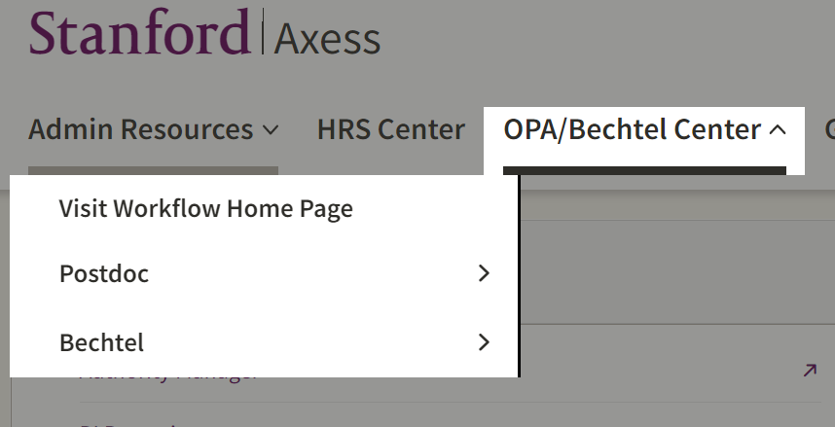
Click Steps:
Navigating the OPA/Bechtel Center Tab
  Click Visit Workflow Home Page
    View your workflow
  Click Postdoc for links to:
    Postdoc Administrative Forms
      Select a postdoc web form
    Postdoc Admin Worklist
      View a list of pending transactions
    My Postdocs
      View a list of all dept postdocs
  Click Bechtel for visa links
https://axess.sahr.stanford.edu/
Click for Workflow
Click for links to web forms or other options

Slide 38
Process: Transaction Request Type
New Appointment, Department Transfer, Returning Postdocs
New Appointments
  Candidate has never been a postdoc at Stanford
  The new appointment process begins with an Invite form (instructions on next slide)
Department Transfers
  Candidate is a Stanford postdoc in another department and is transferring to your department
  The transfer process begins with an approved termination of the current appointment
  Skip the Invite form; begin the transfer appointment with a new Recommendation form
    Obtain the transaction ID of the termination from current department Postdoc Admin to enter in a new Recommendation form
Returning Postdocs
  Candidate was a Stanford postdoc, left Stanford, and is now returning to Stanford as a Postdoc
  Skip the Invite form; begin the return appointment with a new Recommendation form
    Obtain the candidate’s previous Stanford student ID to enter in the new Recommendation form

Slide 39
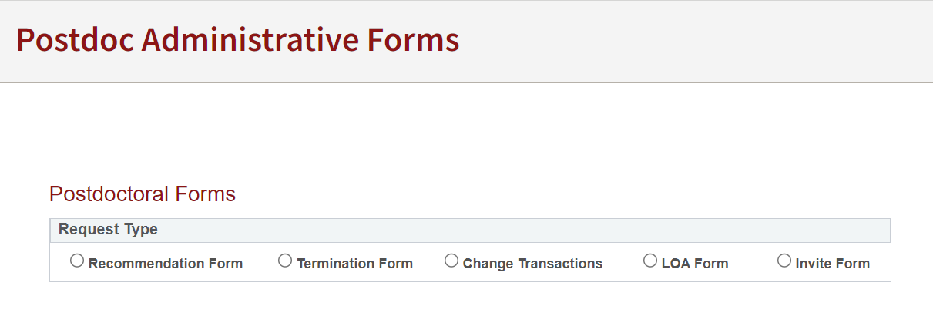
Click Steps:
Initiate a New Appointment Invite
(SKIP SLIDES 40-80 for Department Transfers and Returning Postdocs)
In Axess:
  Click OPA/Bechtel Center tab
  Click Postdoc
  Click Postdoc Administrative Forms
  Click Invite form
  https://axess.sahr.stanford.edu/

Slide 40
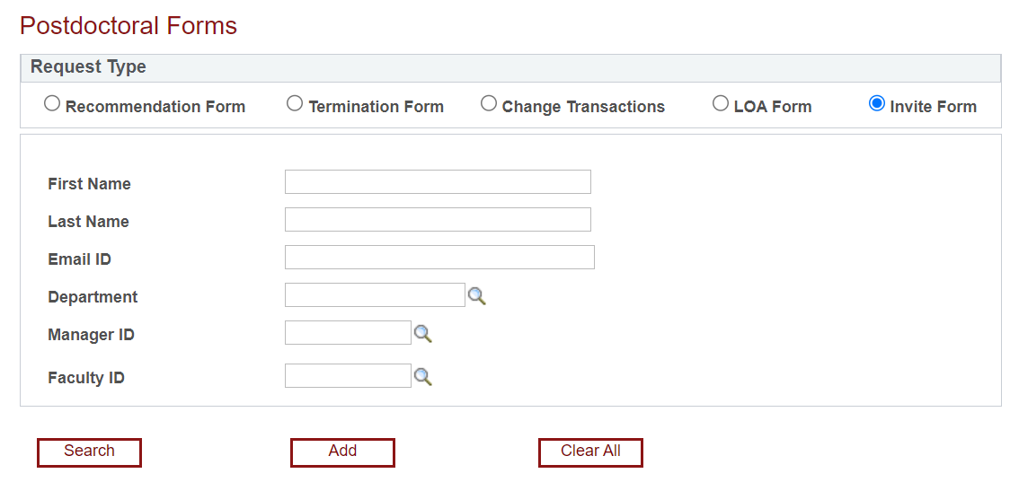
Click Steps:
Initiate an Invite
Skip the search fields
Click Add

Slide 41
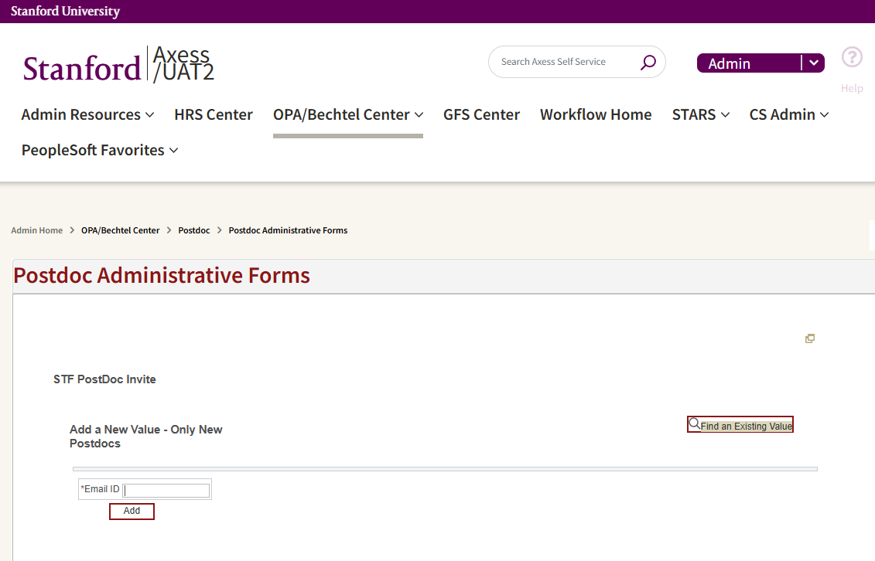
Click Steps:
Add a New Value
Send a New Invite:
  Enter candidate’s email address in Email ID field
    Email address entered must be valid until the appointment is approved
    An email address can be used one time only in secure portal. DO NOT use email address from a prior postdoc invite
    If copying and pasting email address, ensure there are no spaces or a period before or after the email address that you have copied and entered in the Email ID field
  The “Find an Existing Value” tab is used to search for previously sent Invites
Real World Training Scenario:
  Enter Robin’s email address: newpostdoctest.robinhood7490@outlook.com
  Click Add

Slide 42
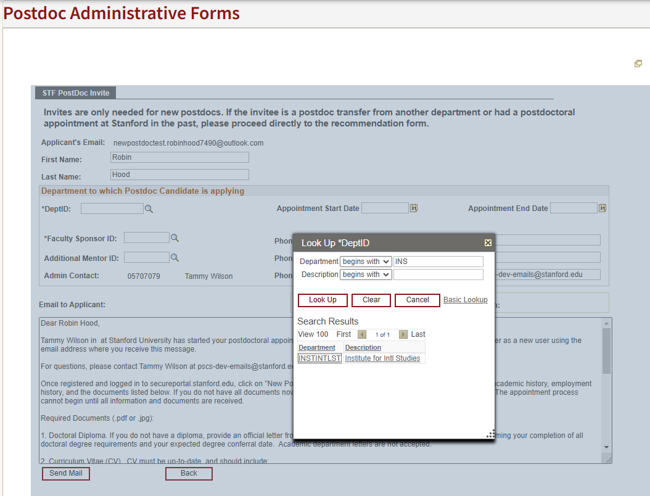
Click Steps:
Invite Form Data Entry
Text Entry Fields:
Enter the Candidate’s first and last names
Enter the Department ID
  Click the magnifying glass to use “Look Up”
    Leave the search fields blank, or enter the first few letters of dept name
    Click Look Up
    The Academic Organization displays
    Click on the Department in the Search Results to populate the DeptID field
Real World Training Scenario:
  Enter Robin Hood’s first and last names
  Look up the Department ID for the Institute for International Studies

Slide 43
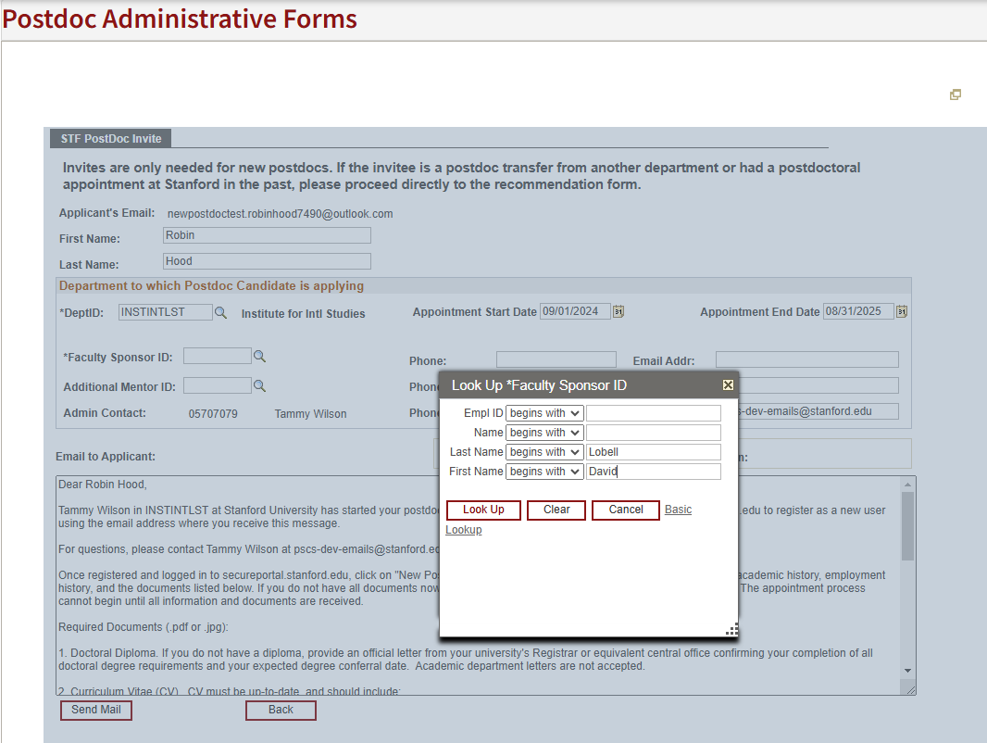
Click Steps:
Faculty Data Entry
Text Entry Fields:
Enter the Faculty Sponsor ID
  If ID is unknown, use Look Up
  If the Faculty Sponsor is not found, they must be added to the advisor/instructor table
    Submit a SNOW help ticket to request the add
Enter the Research Mentor ID
  Leave field blank if there is no Research Mentor
Real World Training Scenario:
  Look up Prof Lobell’s ID number
  Robin does not have a Research Mentor; leave that field blank

Slide 44
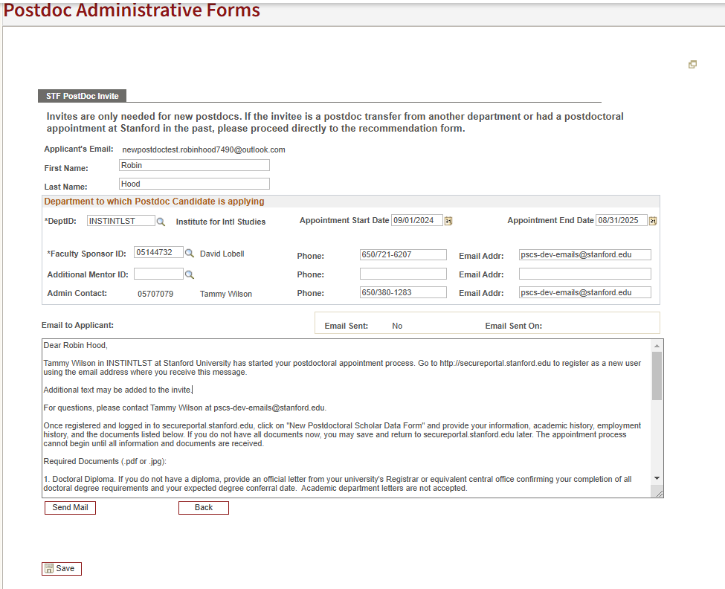
Click Steps:
Save and Send
You may add new text to the standard Invite
  Added text may NOT alter standard invite terms, and must be in accordance with both postdoctoral and University policies
DO NOT delete standard Invite text
Data entered populates the Invite text after you click SAVE
Click “Send Mail” to send the Invite to the Candidate

Slide 45
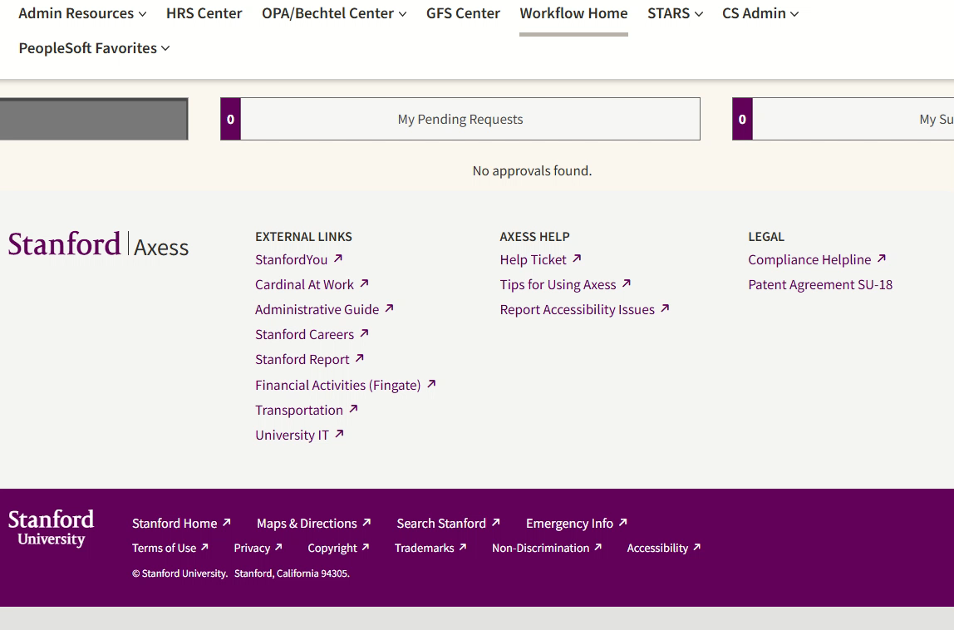
CLICK STEPS VIDEO: NEW APPOINTMENT INVITE

Slide 46
New Appointment
Candidate: View of Invite and Data Form

Slide 47
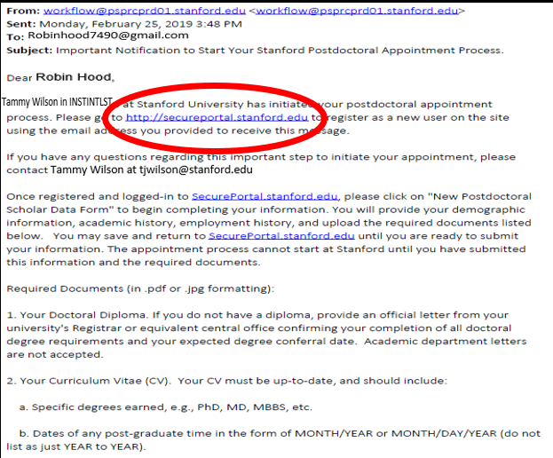

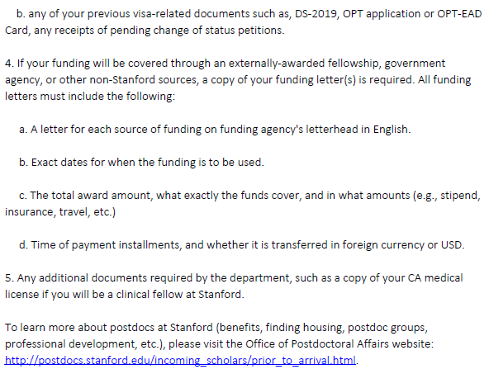
Process:
Candidate’s View of the Invite Email

Slide 48
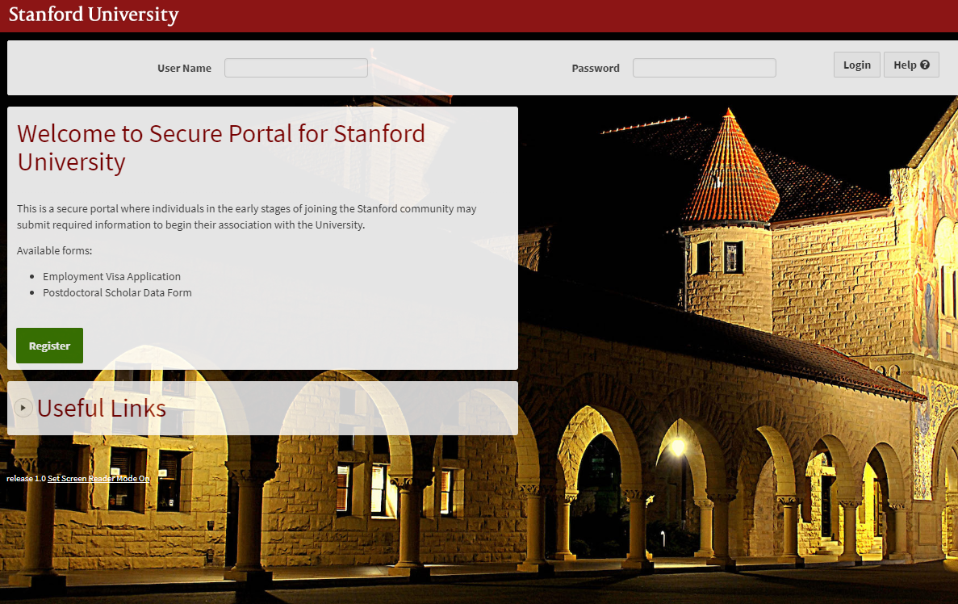
Process:
Candidate Registers a User ID and Password

Slide 49
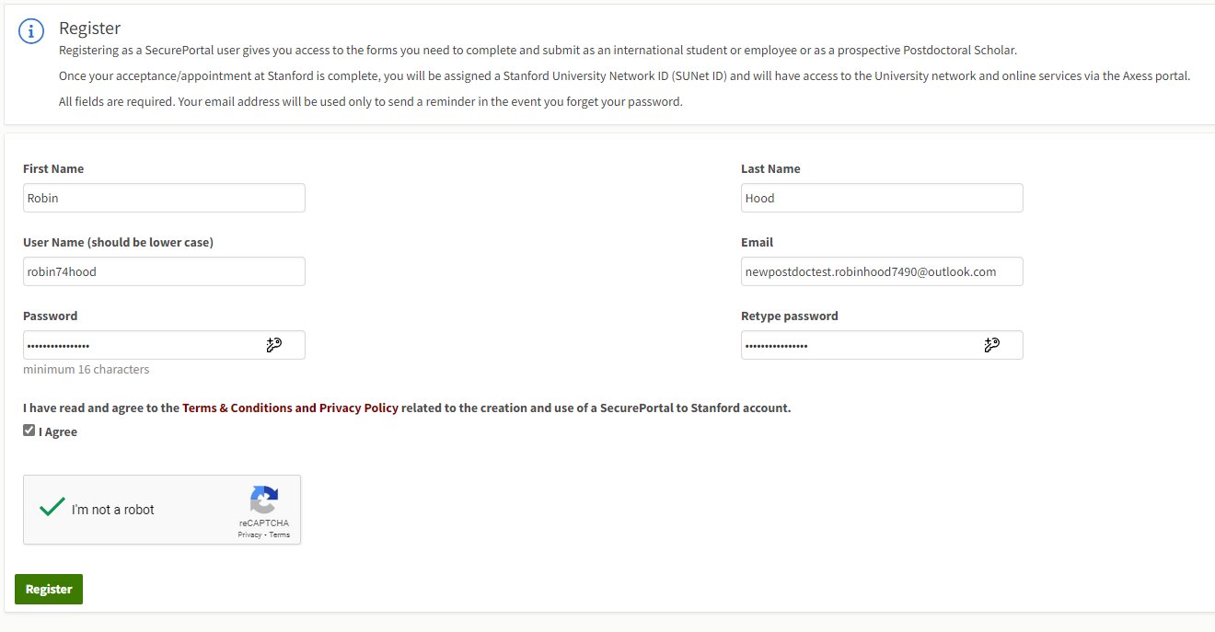
Process:
Candidate Must Use SAME Email Address Where Invite Was Sent

Slide 50
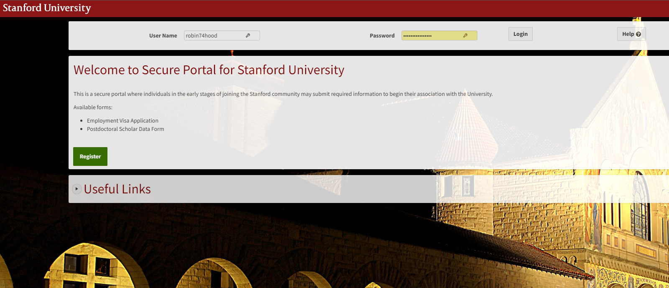
Process:
Candidate Logs in With Created User ID and Password

Slide 51
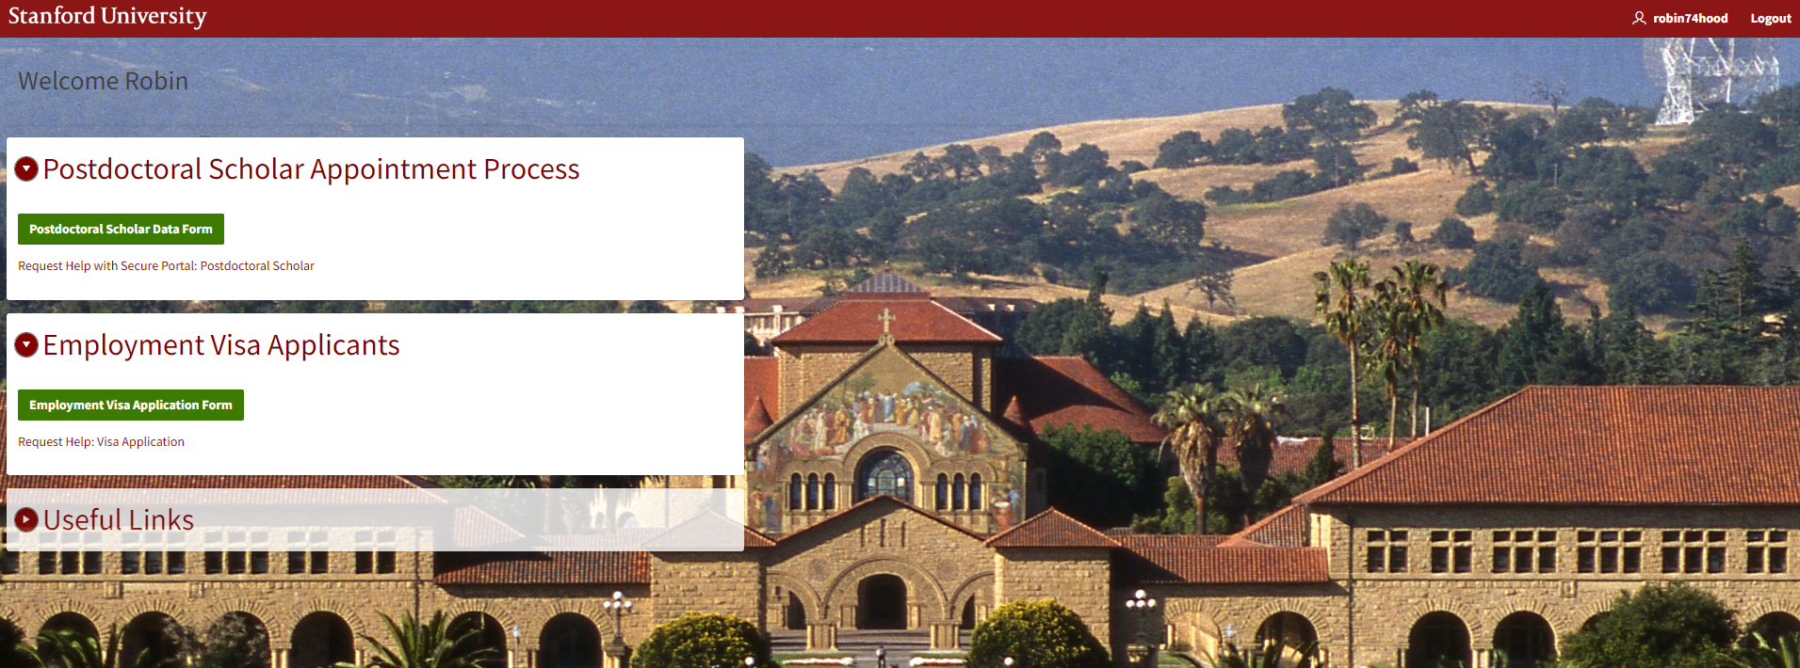
Process:
Candidate Clicks Postdoctoral Scholar Data Form Link

Slide 52
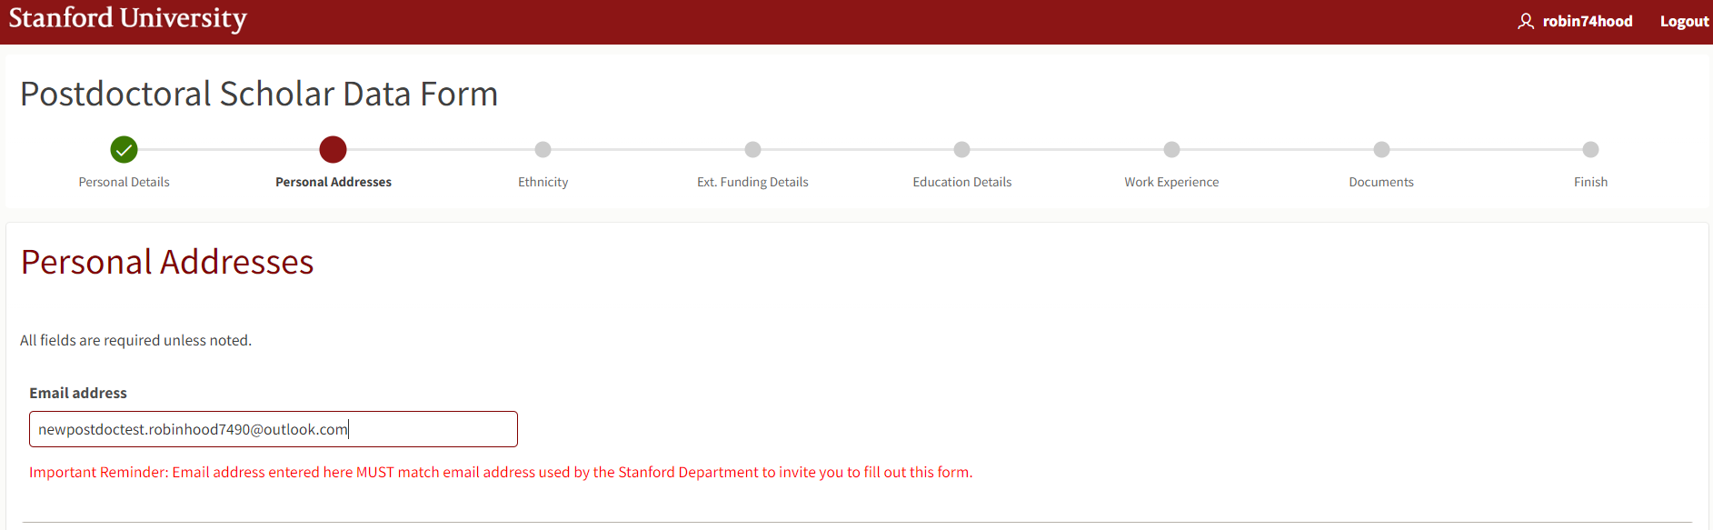
Process:
Candidate Must Use SAME Email Address Here as Previous

Slide 53
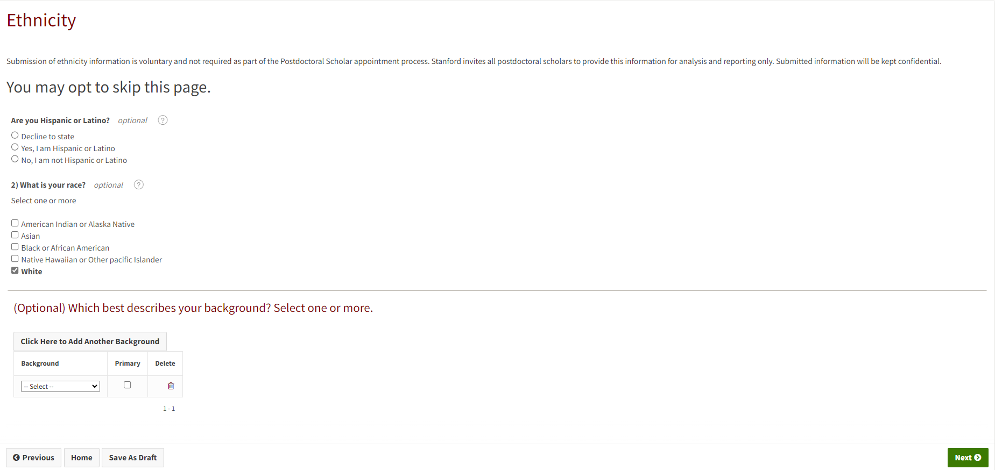
Process:
Candidate May Enter or Skip Ethnicity Data

Slide 54
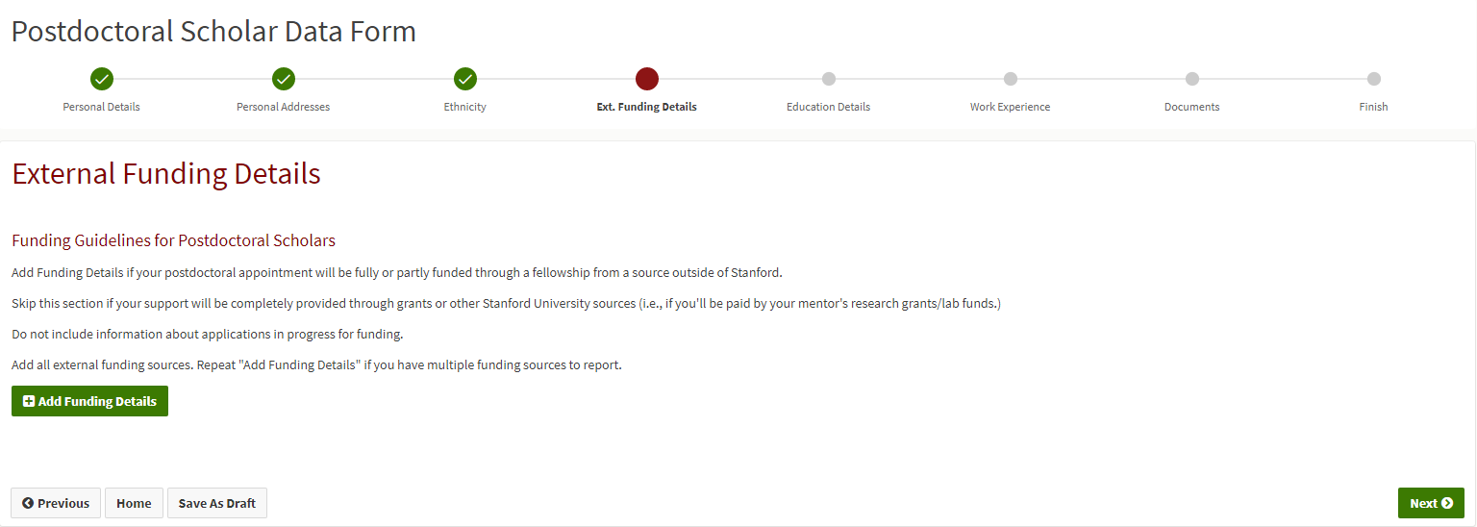
Process:
Candidates With Outside Funding Must Enter Details and Upload a PDF Copy of the Funding Letter

Slide 55
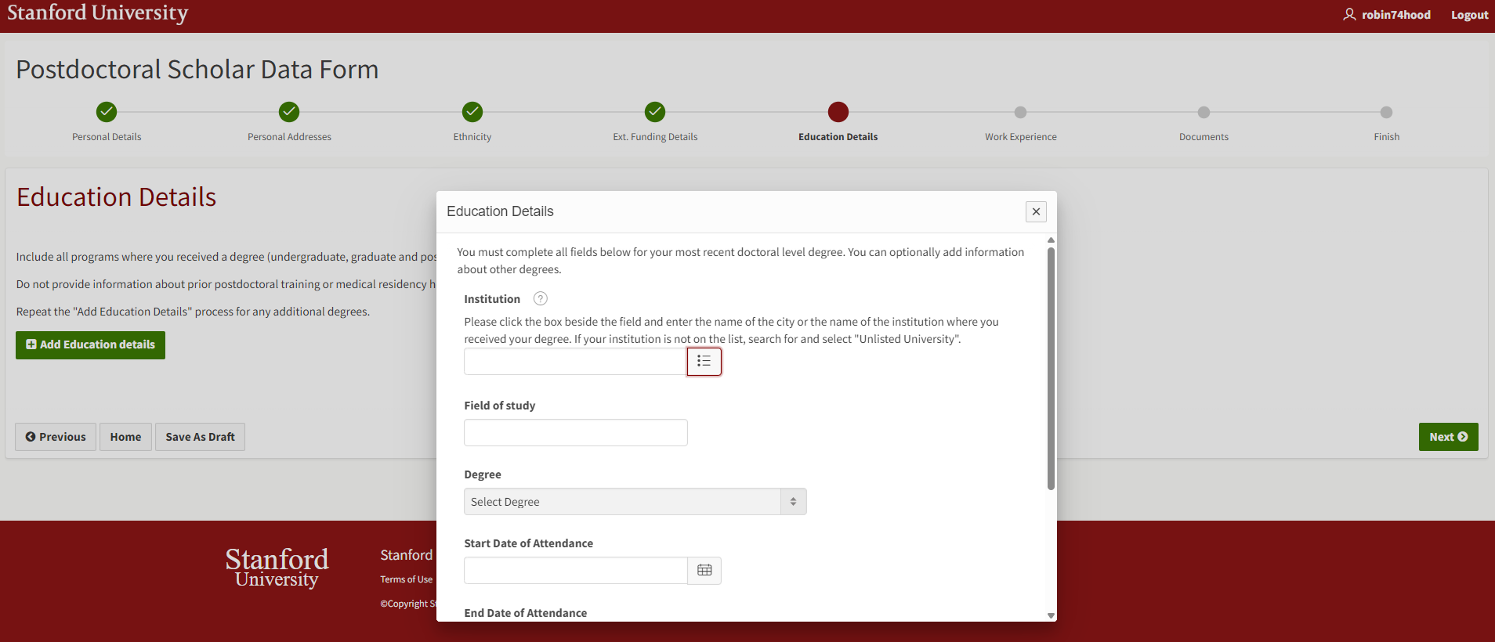
Process:
Candidate Must Enter Educational Data
Doctoral degree information is required
  Entry of undergrad or other graduate degree(s) is optional
Candidate searches for institution in list
  May use “Unlisted School” if PhD or MD institution is not found
  Must click magnifying glass or click Enter to populate search list
Candidate should enter degree information only in this section
  Residencies, postdoctoral fellowships, and other training are entered in the Work Experience section

Slide 56
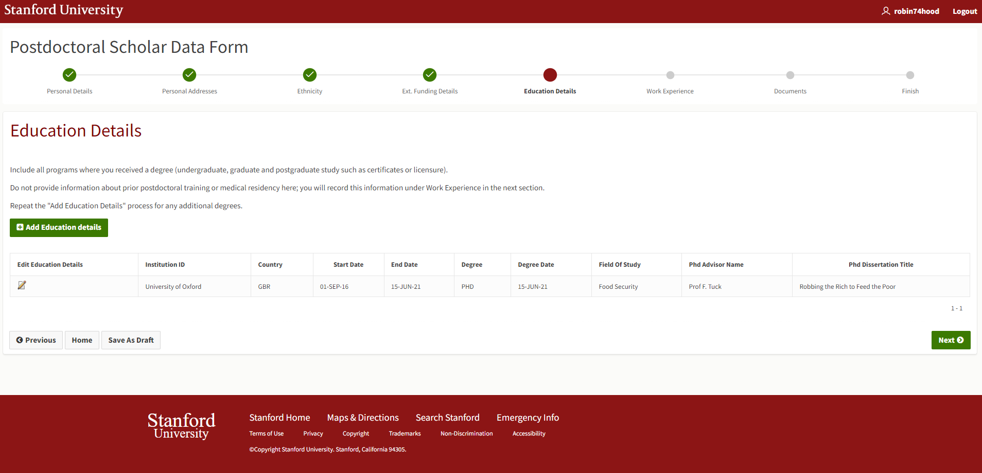
Process:
Candidate Can Return to Previous Page and Edit Saved Entries

Slide 57
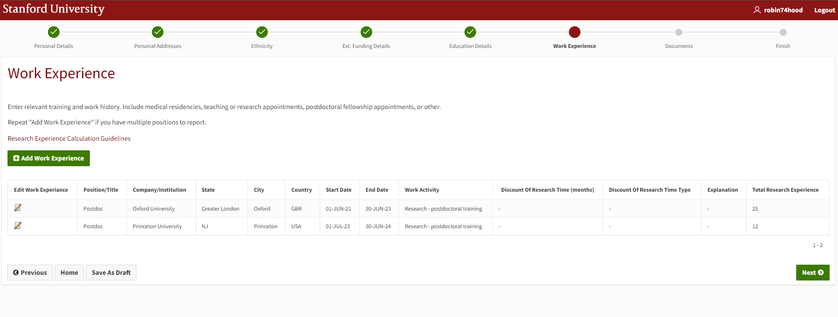
Process:
Candidate Must Enter Work Experience After Doctoral Degree

Slide 58
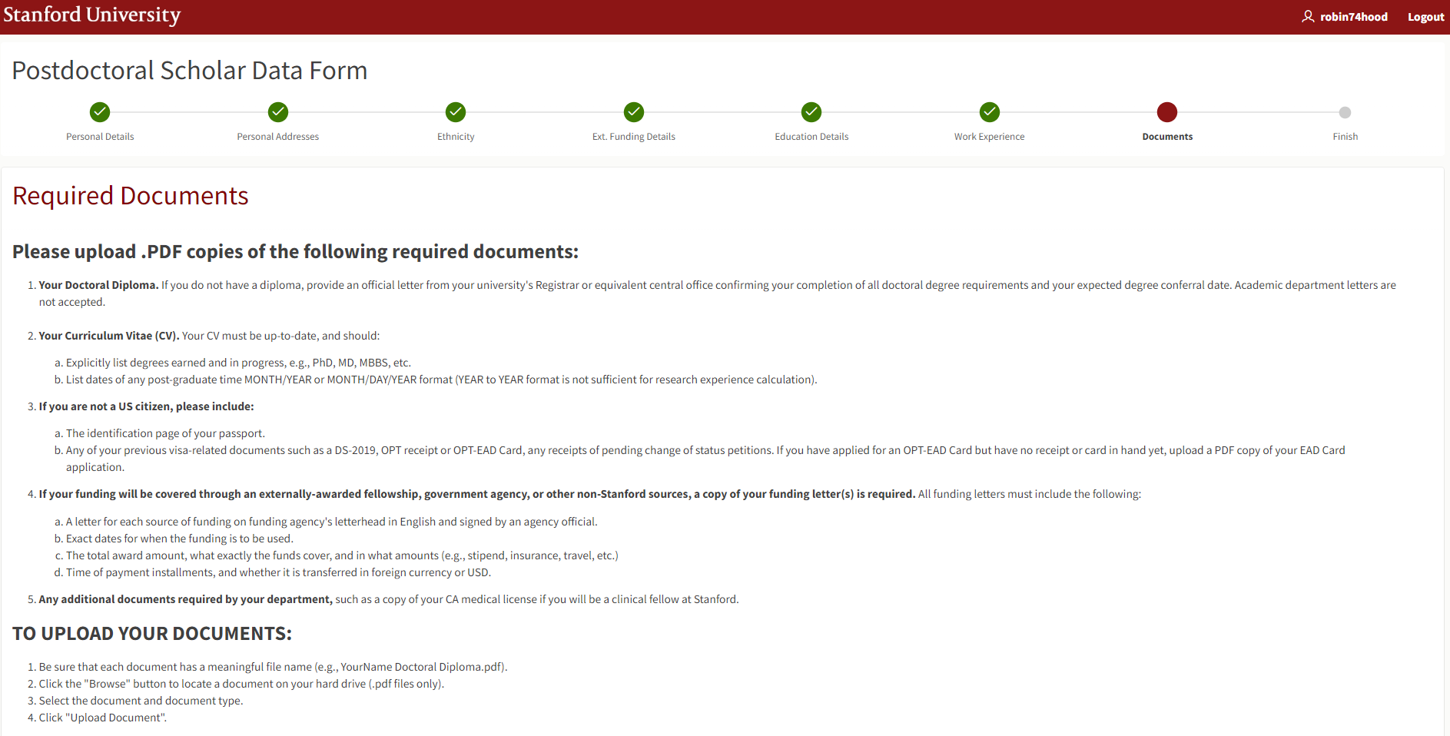
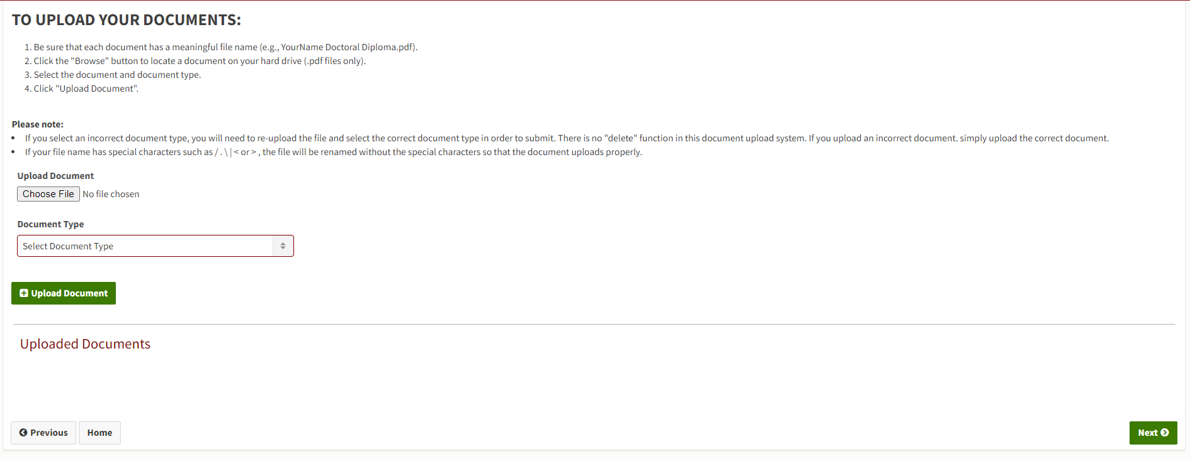
Process:
Candidate Uploads Required Supporting Documents

Slide 59
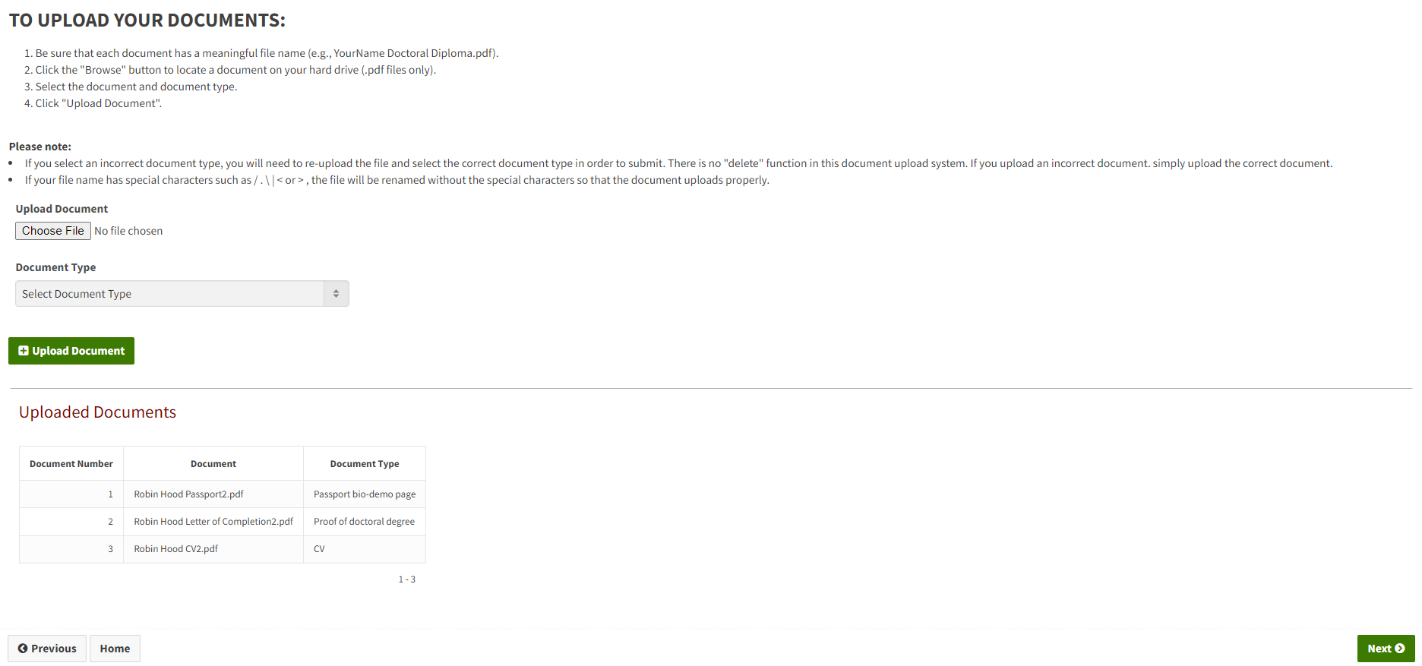
Process:
Candidate Can See Uploaded Document List But Cannot Delete
Only PDF documents
  JPEG, PNG, TIF, and DOCX files are NOT compatible and will not upload
Candidate can email PDF documents to Admin for upload to Rec form if:
  There is an issue uploading documents to Data form
  Sending documents after Data form approval

Slide 60
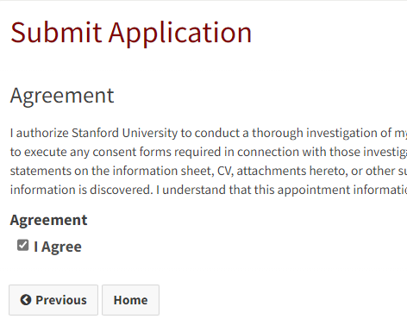
Process:
Candidate Must Click “I Agree” to Submit Data Form
Candidate must agree to a background check
  Appointing department may or may not choose to conduct a background check

Slide 61
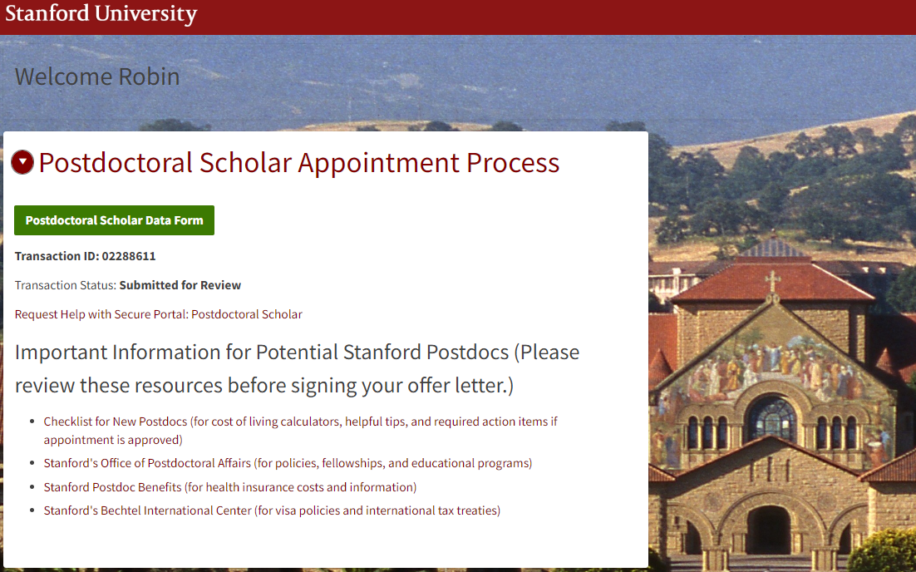
Process:
Candidate’s Data Form Submission Confirmation Message

Slide 62
New Appointment
Postdoc Admin: Data Form Review

Slide 63
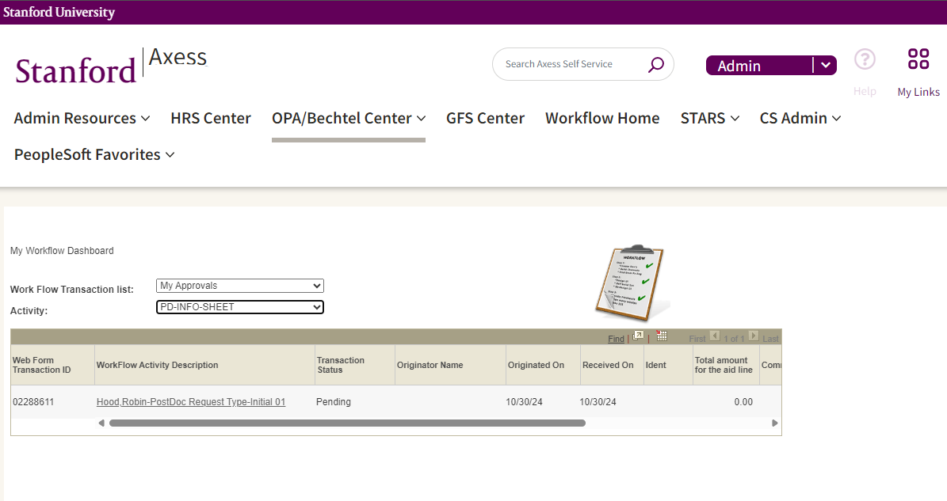
Process:
Review the Data Form (Info Sheet)
Review the Data Form:
  In Axess
  Click OPA/Bechtel Center tab
  Click Visit Workflow Home Page
  Workflow Transaction List field
    Click My Approvals
  Activity field
    Click PD-INFO-SHEET
  Workflow Activity Description
    Click Data form to review
    The Data form opens
  https://axess.sahr.stanford.edu/

Slide 64
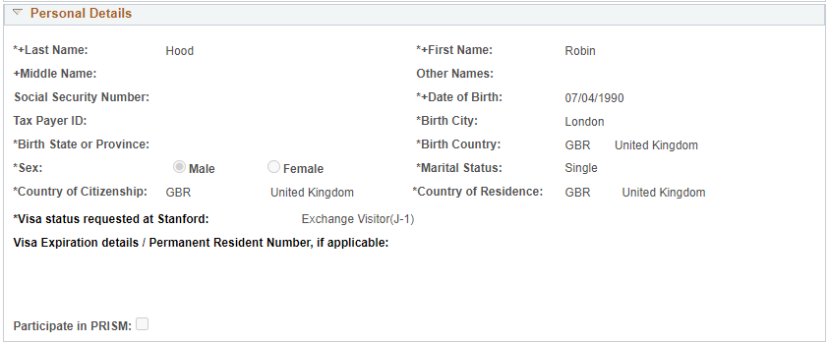
Process:
Review the Data Form
Compare information in the Data form to the uploaded documents
If any data is incorrect:
RETURN the Data form to the Candidate for revision
  Do NOT click DECLINE as this ends the invite process
    Restarting the invite requires a NEW Invite to a NEW postdoc email address

Slide 65
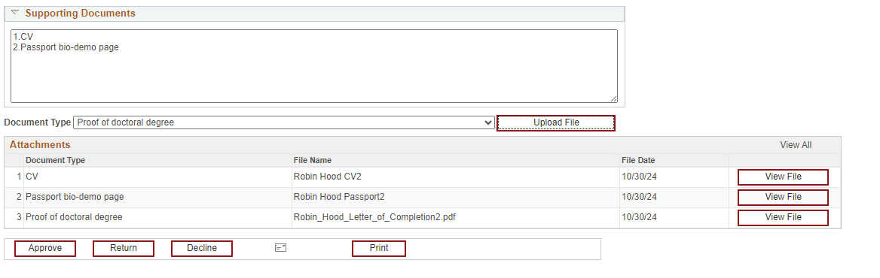
Process:
Scroll down, click on View File to Open a Document

Slide 66
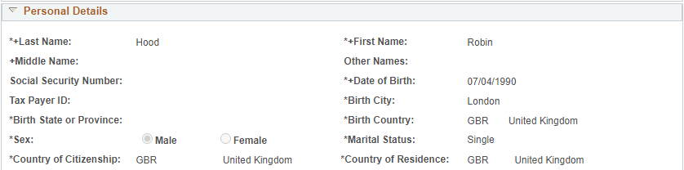
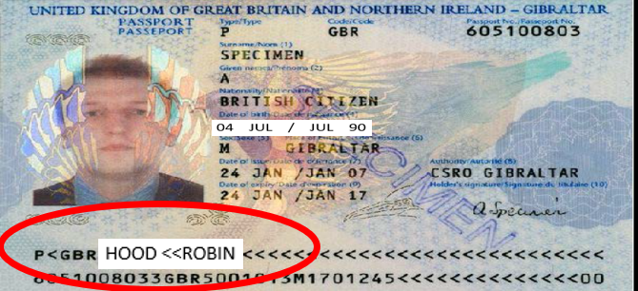
Process:
Review Personal Details for International Scholars
Real World Training Scenario:
Compare to Passport – Name Data
  MUST MATCH passport name data as shown in the machine-readable text on the bottom of the bio/demo passport page
    Good to Know:
      Special characters (accent (é), umlaut (ä), tilde (ñ), etc.) in the name data affects the “Search by name function” in postdoc web forms

Slide 67
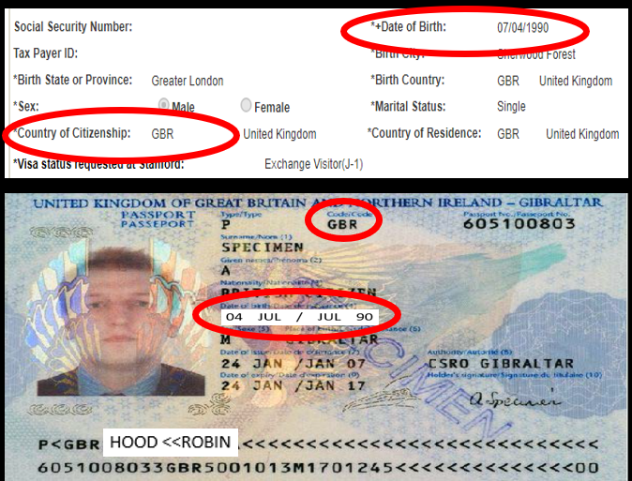
Process:
Review Personal Details for International Scholars
Real World Training Scenario:
Compare to Passport - Birthdate
  Must be in U.S. format (07/04/1990)
    Check for European format (04/07/1990)
    Check for current year in place of birth year (e.g., 07/04/2025)
Birth City/State
  Check for foreign city and US state
    e.g., Beijing, CA

Slide 68
Process:
Review Personal Details for U.S. Citizens
Real World Training Scenario:
Compare to I-9 documents – Name, Birth Date, SSN
  e.g., driver’s license, social security card, etc.
Review Gateway to Financial Activities
  http://web.stanford.edu/group/fms/fingate/staff/payadmin/payadmin_student.html

Slide 69
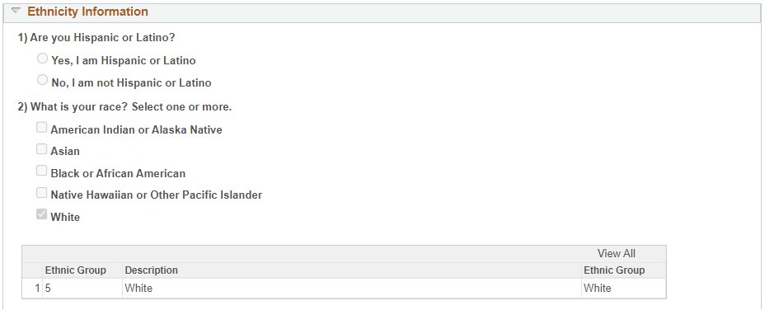
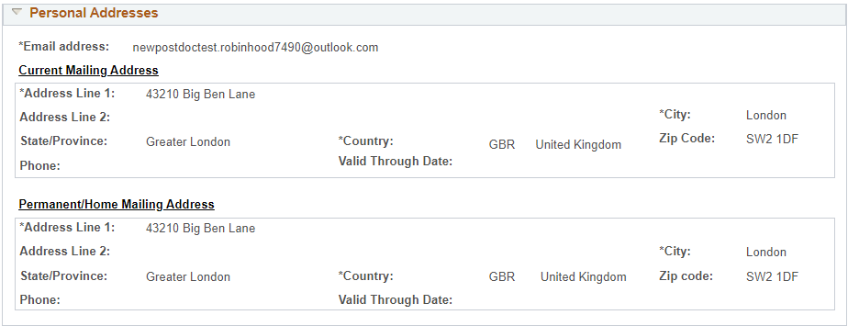
Process:
No Required Review of Ethnicity or Address Data
Ethnicity data does not require Admin review
Address data does not require Admin review

Slide 70
Process:
Review Outside Funding Details
If Candidate selects “Yes”:
  A Notice of Award or Funding Letter must be uploaded

Slide 71
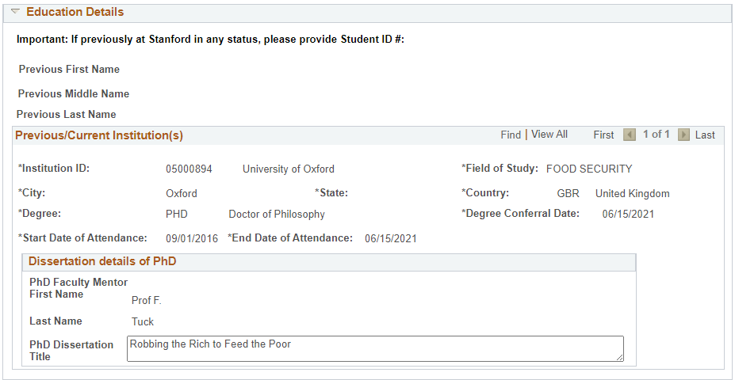
Process:
Review Education Details
Review for missing data or incorrect degree conferral date
  Compare to conferral date on the degree to conferral date entered in Data form
Click “View All” when multiple institutions are entered

Slide 72
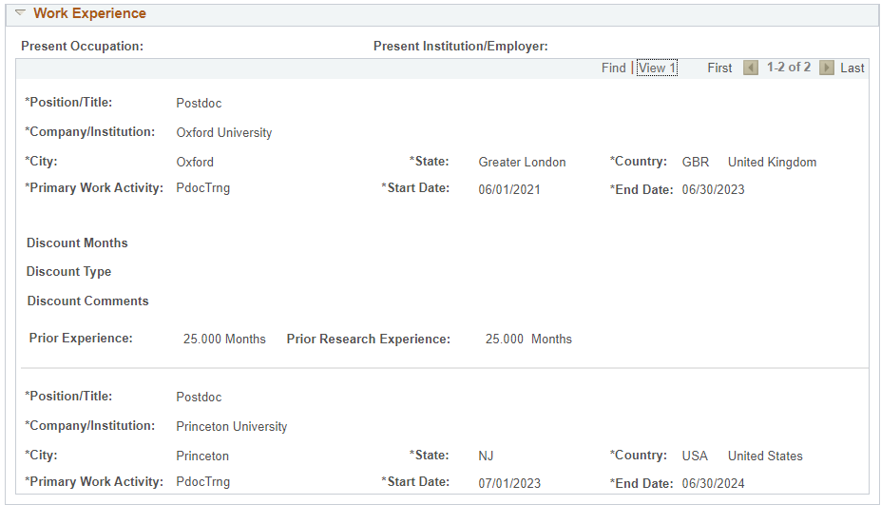
Process:
Review Work Experience Click “View All” for multiple institutions –
Compare Data form to CV
Check for current appointment end date

Slide 73
Process:
Review Work Experience Click “View All” for multiple institutions –
Compare Data form to CV
Check current appointment end date
    Compare prior research experience on Data form and CV
      Is the same research experience noted on both Data form and CV?
      Do the start and end dates of research experience match on both?
        Ask the Candidate to resolve any discrepancies in the Data form and CV
          If the CV is incorrect, Candidate can revise and upload a new CV
          If the Data form is incorrect, Admin can return it to Candidate for revision

Slide 74
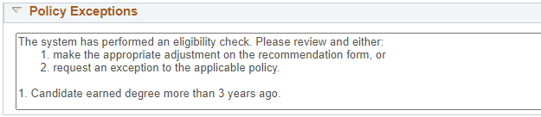
Process:
Review Policy Exceptions
  Data form completes a check for possible policy exceptions:
    Review each policy exception noted
    Determine if the policy exception is applicable
      If not applicable, adjust the data when the recommendation form is created
      If applicable, select each applicable policy exception request checkbox on the recommendation form
  https://postdocs.stanford.edu/postdoctoral-administrators/appoint-postdoctoral-scholars

Slide 75
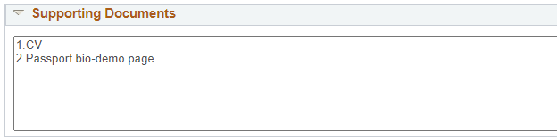
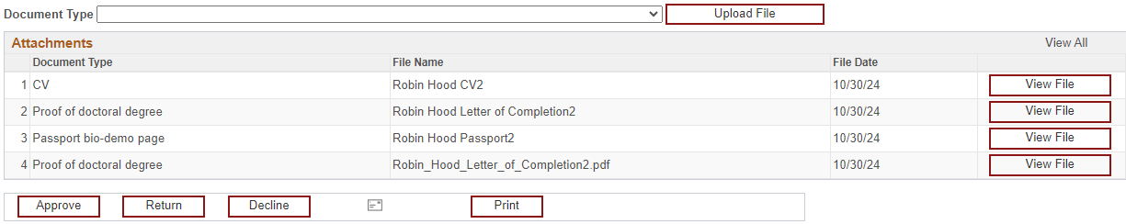
Process:
Review Supporting Documents
  Supporting Documents:
    Review the Supporting Document list
    Candidate must upload a document for each document type displayed
  Attachments
    Review document type
      If type is missing, contact OPA to correct
    Click “View File” to open each document
  https://postdocs.stanford.edu/postdoctoral-administrators/appoint-postdoctoral-scholars

Slide 76
Policy:
For International Scholars:
Review Passport and Work Authorization Documents
  J-1 Scholars:
    Postdoc Admin submits DS-2019 web form with Recommendation form
  F1 OPT Scholars:
    Candidate uploads a PDF copy of the EAD card, or if not yet issued, a PDF copy of the EAD application or USCIS receipt
  H-1B Visa Holders:
    Candidate uploads a PDF copy of the most recent I-797 approval notice
  Permanent Residents:
    Candidate uploads a PDF copy of the Permanent Resident (green card)
  J-1 visa sponsored by Postdoc’s PhD institution:
    Candidate uploads a PDF copy of the current Academic Training DS-2019 issued by the PhD institution
International Scholars must upload:
  PDF copy of bio-demographic passport page
  Any prior US immigration documents (DS-2019s, I-20s, etc.)
https://postdocs.stanford.edu/postdoctoral-administrators/appoint-postdoctoral-scholars

Slide 77
Policy:
For Outside Funded Candidates:
Review Outside Funding Documents
Postdocs with outside, direct-pay funding (not paid through Stanford Payroll) must upload a copy of the Notice of Award or Funding Letter
Funding letters that denote payment in foreign currency must include conversion to USD
  Postdoc Admin must upload a currency conversion printout
  www.oanda.com is a good resource for currency conversion rates/printouts
REMINDER: Postdoc Admin must review currency exchange rates every quarter to ensure outside funding meets the required minimum for the duration of the appointment
  Outside funding that falls below the required minimum must be supplemented up to at least the required minimum by the appointing department / faculty sponsor
https://postdocs.stanford.edu/postdoctoral-administrators/appoint-postdoctoral-scholars

Slide 78
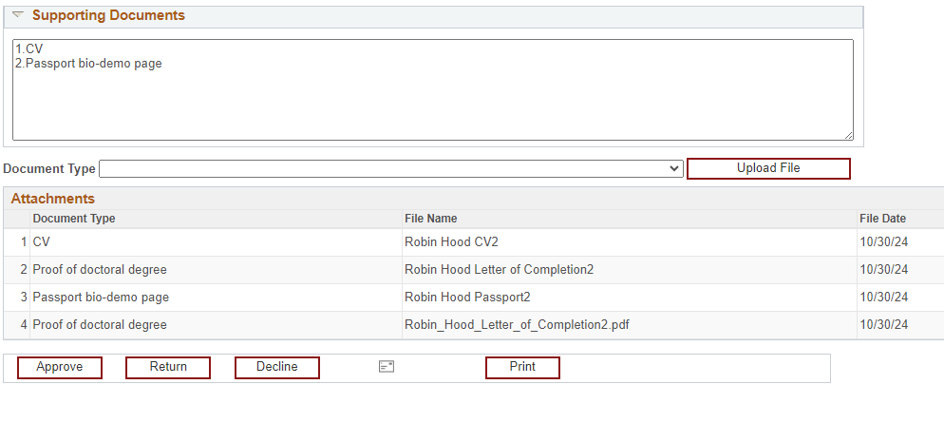
Process:
Finishing the Data Form Review
Action Buttons:
  Approve
    Data form is complete and correct
  Return
    Data form has errors that candidate must correct
  Decline
    ENDS the invite process
    Use ONLY if candidate declines offer
  Print
    Prints copy for PDF or paper file

Slide 79
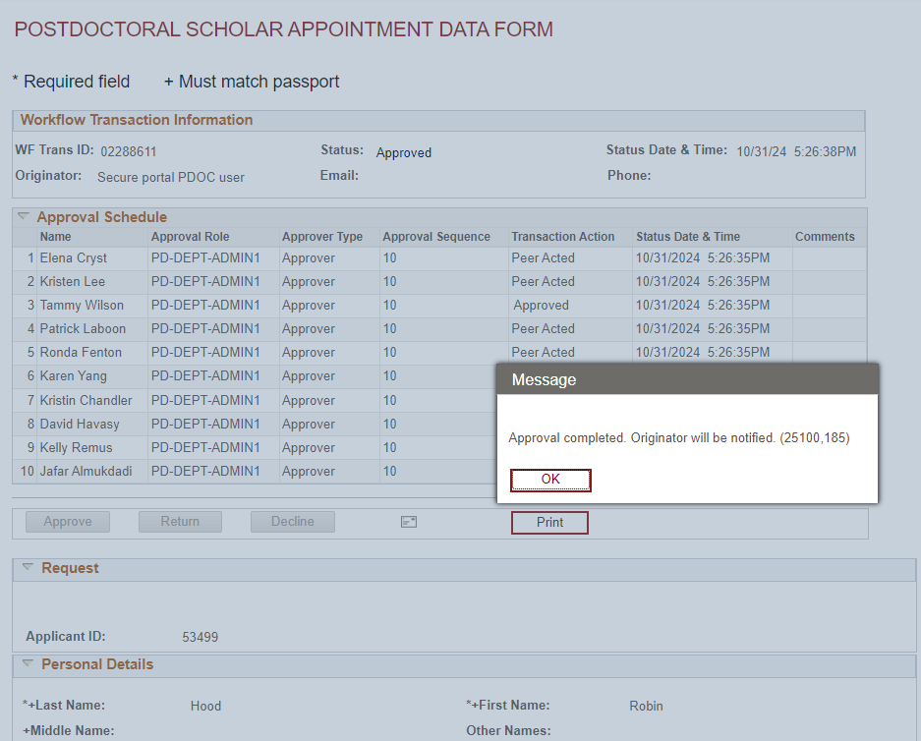
Process:
Admin Approval Message
After approval, the data form is no longer available in workflow
To view an approved data form:
  Create a recommendation form
  Click “Complete Information Sheet” link
  Data form opens
Good to Know:
Copy the data form WF Trans ID number here, for later use with the recommendation form

Slide 80
New Appointment:
Postdoc Admin: Create a Recommendation Form

Slide 81
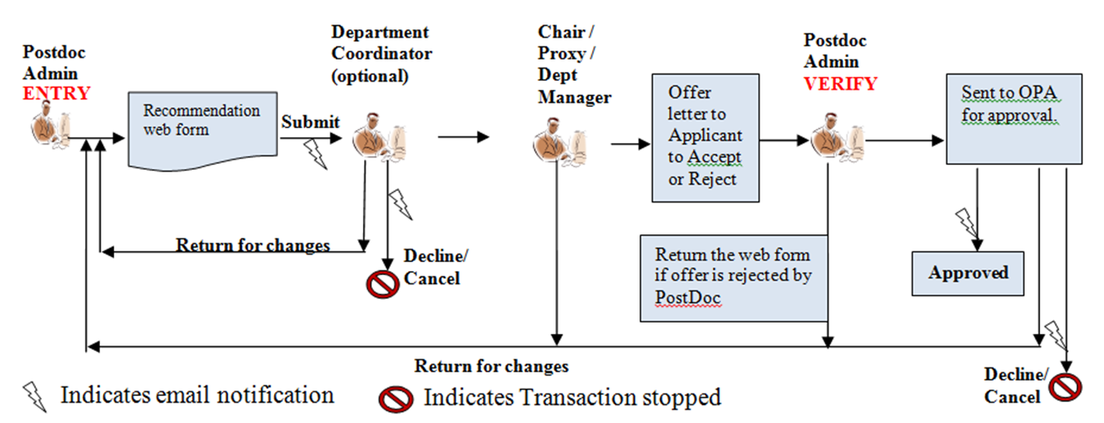
Process:
Recommendation Form in Workflow
Postdoc Admin has two roles in the Recommendation form:
  Admin Entry
    Creates Recommendation form and submits to Department Manager/DFA for approval
  Admin Verify
    Reviews Recommendation form for errors or late changes in appointment terms and submits to OPA for approval

Slide 82
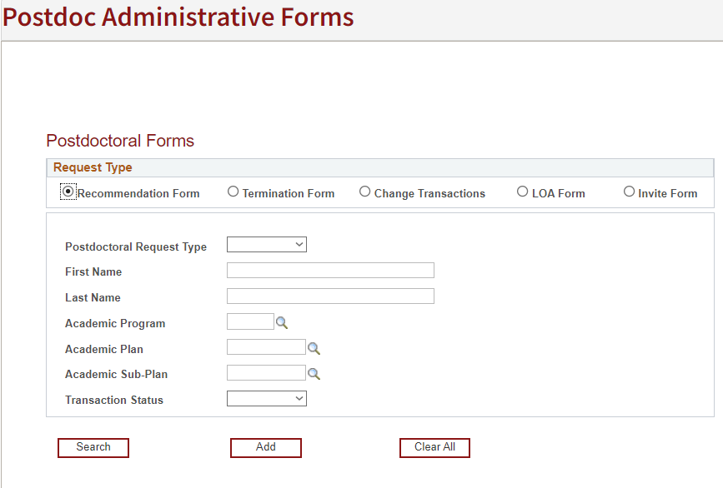
Click Steps:
Create a Recommendation Form
Click OPA/Bechtel Center tab
Click Postdoc
Click Postdoc Administrative Forms
Click “Recommendation form”
The screen populates with Search boxes
  Ignore the search boxes and Search button
  These are used to find EXISTING web forms
Click Add
https://axess.sahr.stanford.edu/

Slide 83
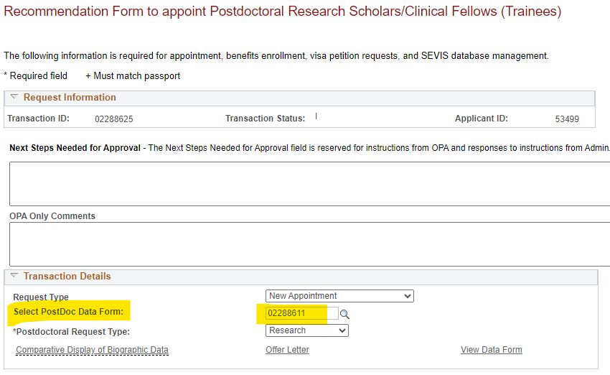
Click Steps:
Transaction Details Box
Text Entry Fields:
Request Type
  New Appointment
    Requires the approved data form ID#
  Department Transfer
    Requires an approved termination form ID#
  Returning Postdoc
    Requires Stanford Postdoc ID# (Empl ID) from previous appointment
Postdoctoral Request Type (determines questions on form)
  Research
  Clinical (Separate training; School of Medicine only)
Three hyperlinks
  Comparative Display of Biographic Data - compares data to DS-2019 form
  Offer Letter - opens the offer letter for review of data entry
    Data entry fields display as blank until data is entered and saved
  Complete Information Sheet - opens the approved Data form

Slide 84
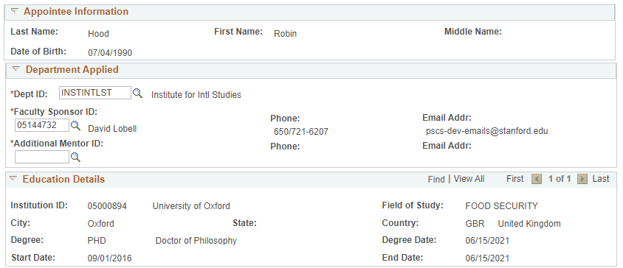
Click Steps:
Transaction Details Box
  Information from the data form populates these boxes:
    Appointee Information
    Department Applied
    Education Details

Slide 85
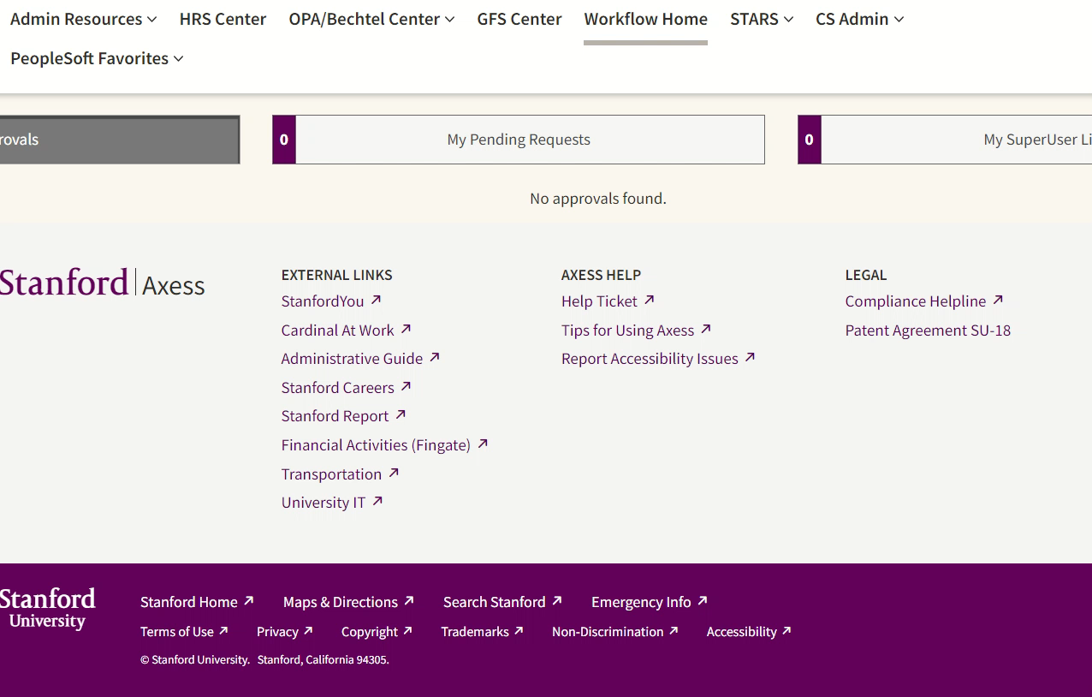
Click Steps Video:
Transaction Details Box

Slide 86
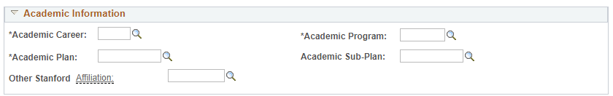
Click Steps:
Academic Information Box
Academic Information Fields:
Data MUST be entered in these fields:
  From left to right across the page
  In this order:
    Academic Career
    Academic Program
    Academic Plan
    Academic Sub-Plan (if any)
    Other Stanford Association (if any)

Slide 87
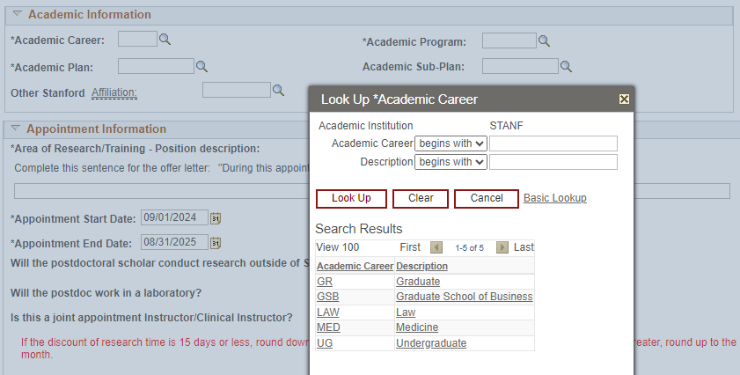
Click Steps:
Academic Information Box
Text Entry Field:
Academic Career
  Click the magnifying glass to Look Up
    All University departments (non-School of Medicine)
        Enter “GR”
    School of Medicine departments:
        Enter “GR” or “MED”
          If unsure check with your OPA SOM Manager
    GSB and LAW departments:
        Enter GSB and Law, respectively
Real World Training Scenario:
  Robin’s career is “GR”

Slide 88
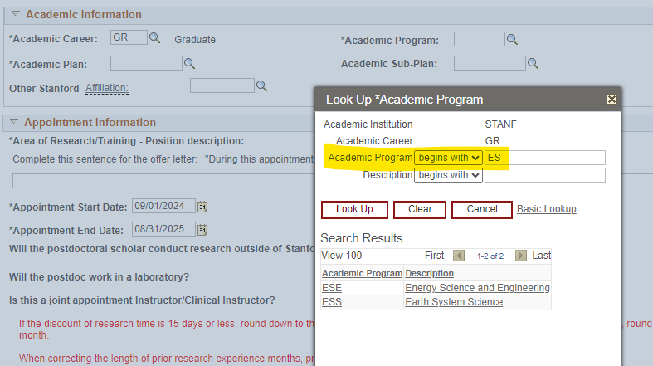
Click Steps:
Academic Information Box
Text Entry Field:
Academic Program
  Click the magnifying glass to Look Up
  Select the Faculty Sponsor’s home department
    If unsure, DO NOT guess!
    Check with your OPA manager
Real World Training Scenario:
  Prof Lobell’s home dept is Earth Systems Science
  Robin’s program is Earth Systems Science (ESS)

Slide 89

Click Steps:
Academic Information Box
Text Entry Fields:
Academic Plan
  Click the magnifying glass to Look Up
  The Plan will show “No Results” when the Program field is blank
Academic Sub-Plan
  Used for only a few Plans in the School of Medicine
  If unsure check with your OPA SOM manager
Real World Training Scenario:
  Robin’s plan is ESS-PD
  ESS does not have a sub-plan

Slide 90

Click Steps:
Academic Information Box
Text Entry Field:
Other Stanford Affiliation
  Used only by non-degree granting programs
    e.g., Freeman-Spogli Institute, Dean of Research units, SLAC, BioDesign, etc.
  If appointing a Postdoc in a non-degree granting program:
    Click the magnifying glass to Look Up
    If unsure, DO NOT guess!
    Check with your OPA manager
Real World Training Scenario:
  Robin’s Other Affiliation is the Center on Food Security and the Environment

Slide 91

Click Steps Video:
Academic Information Box

Slide 92

Click Steps:
Appointment Information Box
Text Entry Field:
Area of Research/Training – Position Description
  Enter a brief description of the training or research the Postdoc will be doing
  Text entered in this field feeds into the middle of a sentence in the offer letter
    DO NOT CAPITALIZE THE FIRST LETTER OF THE TEXT YOU ENTER
    DO NOT TYPE A PERIOD AT THE END OF THE TEXT YOU ENTER
Real World Training Scenario:
  Robin’s area of research is “the exciting world of food security and the environment”

Slide 93

Click Steps:
Appointment Information Box
Offer Letter View
  Text entered in the “Area of Research/Training – Position Description” field populates the offer letter in mid-sentence
  Review the Offer Letter to ensure your data entries populate correctly, for both grammar and punctuation!
  All text entered in the form are highlighted in yellow in the letter.

Slide 94

Click Steps:
Appointment Information Box
Data Entry Fields:
Appointment Start Date
  Enter the requested appointment start date
Appointment End Date
  Enter the requested appointment end date
Offer Letter Date
  Enter an offer letter date
Real World Training Scenario:
  Robin’s appointment dates:
    Start date: 09/01/24
    End date: 08/31/25
    Offer letter date: 07/01/24

Slide 95

Click Steps:
Appointment Information Box
Data Entry Fields:
Will the postdoctoral scholar conduct research outside of Stanford University Campus?
  The default response is “No”
  Click “Yes” if any research will be conducted off campus
    List the location(s) and date(s) of off-campus research
    Postdoc Benefits must be notified when research occurs outside of the benefit plan service area
Real World Training Scenario:
  Robin will conduct research in Tanzania from 01/06/25-02/28/25

Slide 96

Click Steps:
Appointment Information Box
Data Entry Fields:
Will the postdoc work in a laboratory?
  The default response is “No”
  Click “Yes” if Postdoc will work in a lab
  A “Yes” response creates a new question
    “Is this a biosciences lab?”
      Click “Yes” or “No”, as appropriate
Is this a joint appointment Instructor/Clinical Instructor
  School of Medicine use only
  The default response is “No”
  Click “Yes” for joint instructor/clinical instructor appointments
Real World Training Scenario:
  Robin will work in a lab
    Not a biosciences lab
  Robin is not a joint clinical instructor

Slide 97

Click Steps:
Appointment Information Box
Prior Research Experience Table:
Review the research experience table
  Auto-discount up to 12 months in the PhD lab
If needed, the system calculation can be edited
  Enter additional research time or discount time
    If the discount time is 15 days or less, round down to nearest month
    If the discount time is 16 days or more, round up to the nearest month
Enter Additional Research Experience Link:
  See next slide
Data Entry Fields:
Research Experience since last doctoral degree
  System-calculated based on the work experience entered by the Candidate in the Data form
Research Experience noted by department
  Editable field to confirm or revise the system calculation, as needed
Fix number of months in this editable field!

Slide 98

Click Steps:
Appointment Information Box
Enter Additional Research Experience:
When to use:
  Dept Transfers
    Admin must enter research experience from the transfer Stanford appointment
  Returning Postdocs
    Admin must enter all research experience accrued since the previous Stanford appt
  New Appointments
    Admin can add prior research experience here if Candidate omitted prior research experience on the Data form and Admin did not return it for revision

Slide 99
Click Steps:
Appointment Information Box
If Candidate Has NO Prior Research Experience
E.G., DOCTORAL DEGREE WAS JUST CONFERRED OR WILL BE CONFERRED PRIOR TO APPOINTMENT START DATE
Be sure the “Research Experience noted by department” field shows “zero”

Slide 100
Click Steps:
Appointment Information Box
Contact your OPA manager if you are unsure about the research experience calculation
Why is the Research Experience Calculation important?
  Recommendation form will be returned if Research Experience is incorrect
    Minimum annual salary is based on the number of months of research experience
    Prior research experience reduces the time a candidate can be a postdoc at Stanford
      Be aware the 12 month PhD lab discount allows postdoc to maintain postdoc status longer, but reduces the minimum annual salary
      Postdocs who prefer a higher initial minimum salary can waive the discount; discount cannot be taken later to extend appt or avoid a sixth year policy exception request. No gaming the system.

Slide 101

Click Steps:
Appointment Information Box
Data Entry Fields:
If the postdoc has an MD, will they have patient contact?
  School of Medicine use only
  Default response is “No”
  Click “Yes” if SOM Postdoc will have patient contact
Additional Information regarding Patient Contact
  Add any additional details regarding patient contact

Slide 102

Click Steps:
Appointment Information Box
Data Entry Field:
Additional details are in the offer letter
  Creates a new paragraph in the Offer Letter
  Use for additional terms and details not addressed in the standard offer letter text
    Examples:
      Complex funding details
      Details of Postdoc Pay-All Insurance terms
      Reimbursement of moving expenses
      Provision of travel or other non-salary funds
  Added text may NOT alter standard offer letter terms, and must be in accordance with both postdoctoral and University policies
Real World Training Scenario:
  Prof Lobell will reimburse Robin’s moving expenses up to $2,500
  Robin is required to teach a one quarter class as part of his postdoctoral training

Slide 103
Click Steps:
Appointment Information Box
View of the new paragraph added to the offer letter
  Do not enter the period at the end of the final sentence; that will create a double period at the end of the paragraph

Slide 104

Click Steps Video: Appointment Information Box

Slide 105
Policy:
Funding Details Box
Types of Funding
  Salary paid through Stanford Payroll
    Enter on “New Salary” line
  Stipend paid through Stanford Payroll
    Enter on “New Stipend” line
  Outside funding, direct-pay to the Postdoc
    Enter on “New outside support” line
      Examples of Outside Funding
        Home country government
        Educational institution
        Fellowship funding
        Stanford Hospital (SUH)
        Palo Alto Veterans Institute for Research (PAVIR)
General Funding Information
Funding can be from one or more sources, and in any suitable combination of types
The Recommendation form calculates the minimum annual funding rate
The total pay from all sources must meet the minimum annual rate
Personal and family funds are not permitted
https://postdocs.stanford.edu/funding-guidelines

Slide 106
Policy:
Funding Details Box
Minimum funding levels are established by the University annually
  Based on inflation and local consumer price index
New minimum funding levels are published in spring quarter and are effective on September 1 of each year
Funding levels for each postdoc must be reviewed annually
  Minimum funding must be updated each September 1 for all active appointments
https://postdocs.stanford.edu/funding-guidelines

Slide 107
Policy:
Salary and Stipend - Key Distinctions
Salary
Stipend
Pay for work performed
ALLOWABLE on research grants/ contracts
Subject to employment rules, tax withholding
  Receives W-2 form
Fringe Benefits Rate automatically incurred for 20 hours salary or more
  24.6% in FY25
Living allowance for research
NOT ALLOWED on research grants/ contracts
  Except Training Grants, Fellowships
Receives letter from Payroll for taxes
Not permitted for postdocs in H-1B (employment) visa status
Correction from one funding type to another can be very painful. Work with your department’s Research, Grants, and Financial Administrators to determine the correct type of support before making GFS entries

Slide 108

Click Steps:
Funding Details Box
Data entered in these fields populates the offer letter:
Provide these funding details:
  Source/Fellowship Name
  Dates of Funding
    If different from appointment dates
Example entry format:
  Wallenberg Fellowship
  John Doe Gift Funds; 10/01/24-09/30/25
Real World Training Scenario:
  Enter Robin’s funding:
    Description: Prof Lobell’s Research Grant
    Annual Amount: $74,516

Slide 109
Process:
Funding Details Box
Funding MUST be entered as an annual rate
  Even when the appointment term is more or less than one year
The Recommendation form will calculate the “Required Salary” based on the number of research months entered by Postdoc Admin
The “Total Annual Rate” must meet or exceed the “Required Salary” amount
DO NOT include benefits costs, extra allowances, or other non-salary items in the annual rate fields

Slide 110


Click Steps:
Visa Details Box
For International Scholars only:
  Click “Visa Type” field
  From the drop-down list, select the correct visa status
  If the correct visa status is not listed, select any status and note the correct visa status in the “Notes to Approver” field
Real World Training Scenario:
  Robin’s visa status is J-1

Slide 111

Policy Exceptions:
New Appointments
A Policy exception is required for these scenarios:
  Appointment term less than 9 months
    Only for Stanford PhD grads who need time to finish PhD work or bridge time to a new position elsewhere
  PhD conferred more than 3 years ago, or MD conferred more than 6 years ago
  Conditional DS-2019 approval while awaiting final proof of degree
  Other (DO NOT use for 6th year or H-1B visa requests)
How to Request a Policy Exception:
  Select the applicable policy exception checkbox(es)
  Complete the supporting information text boxes
  Upload any required supporting documents
Real World Training Scenario:
  Robin needs a policy exception for an appointment more than 3 years after doctoral degree conferral

Slide 112

Process:
Supporting Documents and Attachments
.
Supporting Documents:
  A list of required supporting documents displays
Attachments:
  Uploaded documents displays
    Admin must upload any missing documents
    Select the Document Type to be uploaded
    Click Upload File
    Choose the file to upload from your hard drive
    Click Upload

Slide 113

Click Steps:
Preview Offer Letter and Notes to Approver
Preview Offer Letter link
  Click Save
  Click “Preview Offer Letter” link
  Review the Offer Letter for proper grammar, punctuation, and word flow where data entries populate the text
  Revise data entry fields to correct word flow, punctuation, grammar, etc., where needed
Notes to Approver field can be used to:
  Explain unusual appointment terms to approver
  Notify OPA of existing Student ID number
  Notify OPA of erroneous data to correct on the Data form
.

Slide 114
Click Steps:
Submission to Workflow
Click “I certify…” check box
Action Buttons
  Save
    Saves data entered in form
  Submit
    Submits to workflow for Role #3 Department Manager/ DFA approval
  Back
    Return to previous screen
  Print
    Prints a copy for PDF or paper file
  Click Submit to send form to Workflow
.

Slide 115

Process:
Role #3 Approver Receives Email Notice

Slide 116

Process:
Role #3 Approver Reviews Recommendation Form
Role# 3 Approver Reviews Recommendation Form
When Role# 3 clicks “Approve”, the Offer Letter is sent to Postdoc
Approver can:
  Approve
    Generates the offer letter
  Return
    To Postdoc Admin for revisions
  Decline
    Ends the appointment process
    Decline only if candidate rejects Stanford offer

Slide 117


Process:
Role #3 Approval Triggers Emails
Approval email to Faculty Sponsor
Email to candidate to review offer letter

Slide 118
New Appointment
Candidate: View of Offer Letter

Slide 119

Process:
Postdoc Candidate Returns to Secure Portal

Slide 120

Process:
Candidate’s View of the Offer Letter

Slide 121

Process:
Candidate Accepts or Rejects the Offer Letter

Slide 122

Process:
Confirmation of Offer Status

Slide 123


Process:
Offer Acceptance Notices
Email Notice to Postdoc Confirming Offer Acceptance
Email Notice to Admin of Postdoc Acceptance

Slide 124
New Appointment
Postdoc Admin: Submit the Recommendation Form

Slide 125

Process:
Return to Workflow to Verify and Submit to OPA
Admin MUST return to workflow for final Verify approval to:
  Confirm appointment terms are accurate
  Confirm all required supporting documents are uploaded
  Submit to workflow
Good to Know:
  A DISABLED/GREYED OUT “APPROVE” BUTTON indicates the Postdoc has NOT accepted the online offer letter
  Appointment cannot proceed until Postdoc accepts the offer letter
    https://axess.sahr.stanford.edu/

Slide 126
Process:
HOLD IT! Are All Required Documents Uploaded?
the rec form will not submit without all required supporting documents.
Documents Uploaded by Candidate
  Doctoral diploma or Letter of Completion
  Current CV
  If International:
    Passport AND:
      EAD Card or application (if F1 OPT)
      Green Card (if Permanent Resident)
      I-797 Approval Notice (if H-1B status)
      Copy of DS-2019 (if sponsored by other institution)
  Outside Funding Letter(s)
    if applicable
Documents Uploaded by Postdoc Admin
  Any missing or previously unavailable documents
  Currency Conversion printout
    if foreign currency is noted in outside funding letter
  Outside funded benefits coverage approval email
    if applicable
  Signed Patient Care form
    SOM clinical appts only
https://postdocs.stanford.edu/postdoctoral-administrators/appoint-postdoctoral-scholars

Slide 127


Click Steps:
Submit the Recommend Form
If all required supporting documents are uploaded, click Approve
Approval comments can be added
Confirmation of Submission

Slide 128



Process:
OPA Approval Notices
Approval Notice to Admin
Approval Notice to Postdoc

Slide 129
Process:
Common Reasons OPA Will Return Rec Form or Delay Approval
Reasons for Returned Recommendation Forms to Postdoc Admin:
  Faculty sponsor is not eligible to appoint a postdoc
  Incorrect Career, Program, Plan, Sub-plan, or Other Association
  Postdoc candidate is not eligible (appointment or employment elsewhere; more than 5 years postdoctoral research experience, etc.)
  Appointment start date not feasible (e.g., timeline too short for visa processing)
  Incorrect Research Experience noted by department
  Additional details added to offer letter that are contrary to Postdoc Policy
  Incorrect Funding
    Amount listed is not the annual rate (appointment period is more or less than one year and funding is prorated for appointment period rather than annual rate)
    Annual rate fields include benefits costs, extra allowances, or other non-salary amounts
Recommendation Form remains pending in OPA workflow until issue resolved:
  Insufficient proof of degree (letter of completion does not meet requirements)
  Missing one or more required supporting documents
  Appointment dates/funding are mismatched with visa dates/funding

Slide 130

Click Steps:
Returned Recommendation Form
What happens if appointment terms change after submission to workflow?
Check Axess to find the pending Approver
  Contact the Approver to return the web form
Postdoc Admin returns Rec form to Self
  If the Rec form is pending Admin’s verify approval, Admin clicks Return, then exits workflow:
    Mouse over the OPA/Bechtel tab
    Click Postdoc Administrative Forms
    Click Recommendation form button
    Search by Postdoc name
    Click the transaction ID, open form
    Make revisions, save, and resubmit

Slide 131
Process:
Delay of Appointment Data Load to PeopleSoft
The Email Notice of Appointment Approval Does Not Mean that Appointment Data is Uploaded to PeopleSoft
  There may be a 24-48 hour delay (longer during high volume processing periods) AFTER the approval notice before the appointment data is uploaded to PeopleSoft
  To check if the appointment is active in PeopleSoft, log-in and look for the student ID number (see the next slide)

Slide 132


Click Steps:
Look Up Student ID in Postdoc Web Forms
CLICK OPA/Bechtel Center tab; click postdoc
Click Postdoc Administrative Forms
Click Change Request; click Add
Click magnifying glass to Look Up
Enter Postdoc names in search fields
click Look Up
Copy the Empl ID#; cancel and exit
If ”No Results”, the appointment data is not yet loaded to PeopleSoft

Slide 133
New Appointment
Postdoc Admin: Visas for International Scholars

Slide 134
Policy:
Visa Types for International Postdocs
J-1 Scholar (with DS-2019 document)
  Expected visa status for Stanford Postdocs
  J-1 visa status available up to a maximum total of 5 years
F-1 Optional Practical Training (OPT) with Employment Authorization (EAD) card
  International Postdocs who were graduate students in the U.S. may start their postdoctoral appointment in F-1 OPT status for the period of the EAD work authorization up to 12 months
  A 24-month extension may be available in STEM research fields, then transfer to J-1 or H-1B visa status
H-1B Visa
  Postdoc must meet eligibility criteria and be approved for this visa policy exception
  H-1B visa status available up to a maximum of 6 years
https://postdocs.stanford.edu/postdoctoral-administrators/how-quick-links/request-visas-postdoctoral-scholars

Slide 135
Process:
Submission of J-1 / Visa DS-2019 Requests
Admin completes J-1/H-1B visa training with Bechtel International Center
Admin submits J-1 / DS-2019 SEVIS Visa Request web form
Funding is required to cover duration of visa and appointment
Submit DS-2019 and Recommendation forms at least 8 weeks before expected Postdoc arrival / appointment start date
  3 months in advance is preferred
OPA CANNOT approve visa web forms without an accompanying Recommendation form

Slide 136
Policy:
J-1 Visa / DS-2019 Processing Guidelines
Appointment start and end dates must match DS-2019 program start and end dates
DS-2019 funding total must match annual funding reported to OPA, EXCEPT:
  When appointment/DS-2019 program do not equal one year
    On the Recommendation form: Enter the annual funding amount
    On the DS-2019 form: Enter the funding amount for program period
  When external funding includes allowances beyond the annual funding amount
    On the Recommendation form: Enter the annual funding amount only; do not include allowances
    On the DS-2019 form: Enter funding amount for program period; okay to include allowances
Recommendation and DS-2019 forms are submitted concurrently to OPA
    https://postdocs.stanford.edu/postdoctoral-administrators/appoint-postdoctoral-scholars

Slide 137
Policy:
Conditional J-1 Visa / DS-2019 Approval Guidelines
To facilitate visa processing for international scholars, OPA may review for a conditional DS-2019 approval in advance of the appointment approval, with:
  Select the Conditional Approval of DS-2019 checkbox on the Recommendation form
  Letter of Completion must provide a statement of progress toward degree
  Letter must provide an anticipated date of degree conferral
  If proof of degree is not provided on or before the postdoc appointment start date:
    The appointment CANNOT start; Postdoc Admin must delay the start date, OR
    The Candidate must be appointed as a Visiting Student Researcher (VSR) or other appropriate status until proof of degree is provided
      Information on Visiting Student Researcher status can be found at:
      GAP policy (Section 1.3); RPH policy; Registrar's Office page
Conditional approval of the DS-2019 is NOT available when the PhD institution has an extended dissertation evaluation process

Slide 138
Process:
F1 OPT and H-1B visa
F1 OPT with Employment Authorization (EAD) Card
  Postdoc applies for EAD Card
    Stanford is not involved in process
  Postdoc uploads to the Data form a copy of the EAD card (if available)
  Appointment can be approved with a copy of the EAD application or receipt if card isn’t available when Postdoc submits Data form
    Postdoc Admin uploads EAD card when available later
H-1B Visa
  Requires an approved policy exception by OPA or the H-1B Review Board
  Postdoc must meet specific H-1B visa eligibility criteria
  Postdoc MUST be paid salary
    Stipend and fellowship are not permitted
  More complex processing required
  More expensive for department
  Conveys other responsibilities to PI
  H-1B Visa Process, Guidelines, and Required Documents

Slide 139
New Appointment
Postdoc Admin: Salary and Stipend

Slide 140
Process:
Paying Postdocs
Postdocs are paid through Graduate Financial Support (GFS)
GFS Mail Code is where the pay stub is sent for stipend-paid postdocs and where the paycheck is sent (if direct deposit is not yet set up)
Postdocs should sign-up for direct deposit as soon as possible after 1st paycheck is issued
Live pay checks are sent to the GFS mail code location
  Postdocs can’t change where checks are sent by changing the mailing address
  They must contact their GFS Administrator to change the GFS mail code
Postdocs MUST check Axess to ensure they have a local mailing address listed
  SEVIS requires international postdocs to list their foreign address as home address
  If no local mailing address is listed the W2 document will be sent to the home address (outside of U.S. for international scholars)
Review Gateway to Financial Activities:
  http://web.stanford.edu/group/fms/fingate/staff/payadmin/payadmin_student.html

Slide 141
Process:
Paying Postdocs
OPA’s responsibilities:
  Create Student ID (Empl ID)
  Term Activation in PeopleSoft Student Administration
  Set up a Benelogic record
Department responsibilities:
  Benelogic entry of PTAs to charge insurance premiums
  Item-Type Requests for New PTAs, if needed
  Entry of GFS Salary, Stipend, Outside Funding lines, as applicable
  Collection of I-9 documents and forwarding to Payroll
    Follow-up with postdoc on missing I-9 documentation

Slide 142
Policy:
Paying Postdocs
Department is responsible for:
  Determining type and level of funding
  Following University policies and funding source requirements
  Meeting minimum funding requirements
Rules, regulations and restrictions regarding source of support:
  Funding source may prohibit support from other sources
  Funding source may require US citizens or Permanent Residents
Funding sources must be coordinated:
  Postdoc and staff must understand and follow requirements of each funding source
  Work closely with your grants and research financial administrators
  Consult trained colleagues; review financial policies
  https://postdocs.stanford.edu/postdoctoral-administrators/how-quick-links/pay-postdocs

Slide 143
Process:
Paying Postdocs
Postdoctoral Scholars Funding Types:
  Stanford Funding
    Grants, contracts, training grants, school/departmental funds, etc.
    Paid as salary (semi-monthly) or stipend (monthly), depending on the funding
  Outside Support (external fellowships)
    Paid directly from outside source to postdoc
    Must be tracked as outside funding in GFS for auditing purposes
  Any combination of funding sources is permitted
  https://postdocs.stanford.edu/postdoctoral-administrators/how-quick-links/pay-postdocs

Slide 144
Policy:
Fringe Benefits Rates Assessed on Salary
Assistantship Type - RAF or RAFC - controls the benefit rate
Full Postdoc Fringe Benefit Rate (24.6% for FY25)
  Charged to all salary entries with Assist Type RAF – when salary accounts for at least 50% of total compensation (at least 20 hours salary)
  e.g., two separate salary lines, one 12 hours and one 18 hours will be charged the full benefits rate
Contingent Benefit Rate (8.5% for FY25)
  Charged to all salary entries with Assist Type RAFC – when salary accounts for less than 50% of total compensation (less than 20 hours salary)
  e.g., one salary line for 10 hours (25% of total compensation) will be charged the contingent benefits rate
  https://doresearch.stanford.edu/research-administration/proposal-preparation-submission/rates#fringe-benefit-rates

Slide 145
Policy:
Annual 9/1 Minimum Funding Increase
All postdocs must be at the appropriate pay level
  Departments must review their postdoc salaries/stipends/outside funding on an annual basis and confirm that their scholars are funded at least the minimum required rate on 09/01/xx
  GFS must be updated with increase
  Funding Guidelines

Slide 146
Policy:
Annual 9/1 Minimum Funding Increase
Postdocs on External, Direct-Pay Funding
  Upload a copy of the award letter
  Outside funding is entered in GFS for audit purposes only
  Foreign currencies must be converted to US dollars
    www.oanda.com is a good resource for currency exchange rates
    REMINDER: Double-check every quarter that currency exchange rates haven’t caused a postdoc to fall below funding minimums
    Foreign funding must be supplemented by department when fluctuation in currency exchange results in a funding shortfall below the required minimum
Postdocs on Unpaid Leave of Absence
  Apply the appropriate salary rate when postdoc returns from leave

Slide 147
New Appointment
Postdoc Admin: Postdoc Benefits, IDP

Slide 148
Policy:
Postdoc Benefits
A postdoctoral appointment at Stanford includes certain defined benefits for medical, dental, vision, disability, and leave benefits
Defined benefits established by the Postdoc Benefits office may not be modified or diminished by individual agreement between the postdoc and the appointing department or faculty sponsor
Postdoc Benefits are managed via a third-party platform, Benelogic
  Information on training and access to Benelogic is here

Slide 149
Policy:
Postdoc Benefits Funding
Stanford’s portion of postdocs’ benefits costs are paid from:
  The automatic application of a fringe benefits rate on salaries of at least 50% FTE, which are paid to the postdoc through GFS, OR
  From departmental or faculty funds, in the absence of a 50% FTE level of salary support
  In rare cases, benefits costs are paid from fellowship funding specifically allocated for the postdoc’s insurance premium costs

Slide 150
Policy:
Postdoc Benefits Session
Benefits session is mandatory for all new postdocs
Postdoc admin registers incoming postdocs for the first session following their arrival at Stanford
Go to Postdoc Benefits for sessions dates, times, and location
Email postdocbenefits@stanford.edu with Benefits questions
Benefits coverage enrollment is not approved until Postdoc has attended session
Postdocs must make benefits elections within 30 days of the appointment start date or will default into basic coverage

Slide 151

Policy:
2025 monthly contribution rates
Institutional costs are funded from a variety of sources depending on each individual postdoc’s appointment arrangement
Upon enrollment, eligible family members (spouse,/registered domestic partner and children through age 25, regardless of student or marital status) are automatically covered.
https://teamcreativa.com/SUPD/2025/SUPD-2025-Rate-Sheet.html

Slide 152
Policy:
Waiving Stanford Benefits Coverage
Postdocs with an outside health plan may request to waive Stanford Benefits
Requires proof of other comprehensive medical coverage
    Usually from a working spouse
    Travel policies do not offer comprehensive coverage
Outside health plans must substantially meet ACA minimum requirements for approval
The outside plan must be approved by the Postdoc Benefits office prior to appointment approval
Admin must upload a PDF copy of the Benefits waiver approval email to the recommendation form
  https://postdocbenefits.stanford.edu/eligibility-enrollment/waiving-stanfords-medical-insurance

Slide 153
Policy Exception:
Postdoc Pay-All
Some outside funding agencies provide funds above and beyond the annual stipend specifically for health benefits charges
  In these cases, funds may be used to cover the Institutional (department) portion of the health insurance premiums (see Postdoc Health Premiums Rate Sheet)
  The department MUST make a formal request to OPA (Postdoc Pay All Job Aid)
  Pre-Approval Required! The formal request MUST be submitted for review prior to the Recommendation form submission to avoid the department having to pay for the insurance from a guarantee account if the exception is not approved
  Because this is an exception to policy, no arrangements will be recognized until reviewed and approved by the OPA Benefits Office
  If approved, Admin must upload a PDF copy of the Benefits postdoc-pay-all approval email to the recommendation form

Slide 154
Individual Development Plan (IDP)
Meetings and Reports

Slide 155
Policy:
Individual Development Plans (IDP)
All postdocs must complete an Individual Development Plan (IDP)
  Requires a meeting with their appointing faculty sponsor
  Must occur within first 90 days of appointment start date
  Research mentors are not eligible to conduct IDP meetings
After the meeting, the postdoc reports the meeting date in the IDP system
The faculty sponsor receives an email to confirm the meeting in the IDP system
Postdoc Admin can view and download IDP meeting reports for department or individual PIs
https://postdocs.stanford.edu/current-postdocs/navigating-your-individual-development-plan-idp/your-individual-development-plan

Slide 156
Change Form
Postdoc Admin: Process Overview, Processing Guidelines, Appointment Extensions, Faculty Sponsor Changes, Start Date Changes, Correction of Previous Research Experience

Slide 157
Change Form:
Process Overview
Change Form Process Overview
  Postdoc Admin (Role #1) monitors appointment terms and submits a Change form when changes occur
  OPA reviews and approves Change forms
    No Role #3 approval for changes
  https://postdocs.stanford.edu/postdoctoral-administrators/how-quick-links/extend-postdoctoral-appointments
When appointment terms change, the Change form is used to update the Postdoc record
Changes reported via Change form:
  Extend the appointment end date
  Change the appointment start date
  Change faculty sponsor
  Change or add Research Mentor
  Correct previous research experience

Slide 158
Process:
Change Form Processing Guidelines
Appointment extensions – Postdoc admin submits at least 3 months prior to appointment end date
  Extension should be discussed by faculty sponsor and postdoc early to allow for 3 month lead time
Extensions with a 6th training year request – Postdoc admin submit 4-5 months prior to appointment end date
Extensions that include a visa extension – Postdoc admin submits to accommodate visa processing timeline
Extensions for outside-funded Postdocs – Postdoc admin must upload an updated funding letter
Appointment start date changes, Faculty changes, and previous research experience corrections – Postdoc admin submits when informed of change
https://postdocs.stanford.edu/postdoctoral-administrators/how-quick-links/extend-postdoctoral-appointments

Slide 159
Process:
J-1 / DS-2019 visa extension processing guidelines
OPA CANNOT approve visa extensions without an appointment extension Change form
Appointment extension and visa extension end dates MUST match
Upload any required supporting documents to avoid processing delay
  E.g., outside funding letters; externally sponsored DS-2019 documents, etc.
J-1 Scholars: Submit Change form and DS-2019 extension form
  DS-2019 funding total must match annual funding reported to OPA, except when:
    When appointment/DS-2019 extension does not equal one year
      Report to OPA: Annual funding amount
      Report to Bechtel: Funding amount for extension period
    When external funding includes allowances beyond the annual funding amount
      Report to OPA: Annual funding amount (do not include allowances)
      Report to Bechtel: Funding amount for extension period including allowances
https://postdocs.stanford.edu/postdoctoral-administrators/how-quick-links/extend-postdoctoral-appointments

Slide 160
Process:
F1 OPT / H-1B Visa Extension Processing Guidelines
OPA CANNOT approve visa extensions without an accompanying Change form
Appointment extension and visa extension end dates MUST match
F1 OPT:
  Submit Change form (new end date should match STEM / EAD card end date)
  Upload a PDF copy of STEM extension EAD card
    (or submit documents/web forms for transition to J-1 or H-1B)
H-1B Visa:
  Submit Change form and H-1B visa form
  Submit an H-1B/E-3 Visa Request Form smart sheet and required supporting documents
https://postdocs.stanford.edu/postdoctoral-administrators/how-quick-links/extend-postdoctoral-appointments

Slide 161
Policy Exceptions:
Existing Appointments
Over the course of a postdoctoral appointment, circumstances may change such that a policy exception review is needed for the appointment to continue
Examples:
  Reduction of required 100% FTE
    Generally approved only for cases of medical illness or injury, or baby-bonding
  Other (DO NOT use for 6th year or H-1B visa requests)
How to Proceed:
  On the Change form, select the applicable policy exception checkbox(es)
  Complete the supporting information text boxes
  Upload any required supporting documents

Slide 162
Policy Exceptions:
Supporting Documents Required
Policy Exception for a Sixth Year of Postdoctoral Training
  Appointment extensions that exceed the 60-month term limit may be permitted if approved by the Faculty Subcommittee
  The maximum term limit is 72 months
  How to Proceed:
  Submit a Change form with end date that extends past 60 months of total research experience
  Complete the required supporting text box responses
  Change form routes to Postdoc and Faculty Sponsor for their responses

Slide 163

Click Steps:
Create a Change Form
In Axess:
  Click OPA / Bechtel Center tab
  Click Postdoc
  Click Postdoc Administrative Forms
  https://axess.sahr.stanford.edu/

Slide 164

Click Steps:
Add a Change Form
Click Change Transactions
The screen populates with Search boxes
  Ignore the search boxes and the Search button
  These are used to find EXISTING web forms
Click ADD

Slide 165

Click Steps:
Change Types
Select the Request Type(s) for the change(s)
  Multiple changes can be submitted on one form
    Except sixth year policy exceptions, these require a separate form
Corresponding boxes display
  Appointment date change checkbox
    Extend appointment end date
    Revise appointment start date
  Faculty change checkbox
    Change Faculty Sponsor
    Add/change research mentor
  Research Experience checkbox
    Correct the number of months of previous research experience or add a discount of research time
  Policy Exception checkbox
    Submit a specific policy exception request

Slide 166
Apply Your Knowledge:
Update Appointment Terms
Real World Training Scenario:
  Robin’s appointment is going well as the end of his first year approaches
  Prof Lobell will extend Robin’s appointment for an additional two years, to meet the maximum term limit of 60 months of research experience
  Prof Lobell will be on sabbatical for the last 12 months of Robin’s appointment; the Faculty Sponsor will change to Prof Eric Lambin at that time
  The annual minimum funding increase on 09/01/25 will increase Robin’s salary – the new amount must be entered in GFS
  Robin took a 90 day unpaid leave of absence (LOA) for professional development
    His research experience can be discounted by 3 months for the unpaid leave time
    His appointment can be extended by 3 months to make up for the unpaid leave
Create and submit Robin’s Change form
  REAL WORLD NOTE: Change forms are submitted over time as changes occur, rather than all at once as in this example

Slide 167


Click Steps:
Enter the Student ID Number
Enter Robin’s Student ID# or click the magnifying glass to Look Up
Bio/Demo box populates with Robin’s current appointment data
Click all applicable change type buttons

Slide 168


Click Steps:
Appointment Date Change Box
“New Appointment Start Date” field
  DO NOT change the auto-populated start date for appointment extensions
  The auto-populated start date changes ONLY when a new appointment is starting earlier or later than the date shown on the form
    The form confirms the start date change is correct to avoid errors
Real World Training Scenario:
  Leave Robin’s start date as auto-populated

Slide 169

Click Steps:
Appointment Date Change Box
“New Appointment End Date” field
  Enter new end date to extend appointment
  Tab out of end date field to recalculate “Total Research Experience…”
  International Postdocs: visa status must be extended to same new end date
    Submit DS-2019 extension form
    Submit H-1B visa extension form
    Upload PDF of extended EAD or PR card
Real World Training Scenario:
  Enter Robin’s new end date: 11/30/27
    2 year extension (08/31/25) plus 3 months to recover 90 day unpaid LOA

Slide 170
Click Steps:
Appointment Date Change Box
“Total Research Experience with Reappointment Term included:” field
  If this number is 61 or more
    Shorten the end date until number is 60 or less, OR,
    Submit a 6th Year policy exception request
Real World Training Scenario:
  Robin’s research experience of 60 months does not require a policy exception request

Slide 171

Click Steps:
New Faculty Sponsor Information Box
“Faculty Sponsor” field
  Enter new faculty sponsor ID number or click magnifying glass to Look Up
“Faculty Research Mentor” field
  Enter new research mentor ID number or click magnifying glass to Look Up, if applicable
“Comments” field
  Add comment to explain change in faculty sponsor or research mentor
Real World Training Scenario:
  Enter Robin’s new faculty sponsor and explanation for the change

Slide 172

Click Steps:
Research Experience Box
Research Experience should be revised when:
  Error is found in original calculation
  Postdoc took unpaid leave of absence
“Correction to Prior Months…” field
  Enter the revised number of months
“Additional months leave” field
  Enter number of months of leave
“Notes” field
  Enter note to explain revision(s)
Real World Training Scenario:
  In the “additional months leave” field enter 3 for Robin’s 90 day unpaid leave
  Add a note of explanation

Slide 173

Click Steps:
Text Fields and Action Buttons
“Additional Information regarding terms” field
  Enter additional information to explain any non-self-explanatory changes
“Comments” field
  Enter any comments to OPA approver
Action Buttons
  Save – saves data entered in form
  Submit – submits to workflow
  Back – returns to previous screen
  Print – prints a copy for paper files

Slide 174



Click Steps:
Change Form Postdoc Admin Notices
Admin Form Submission Notice
Admin Email Approval Notice after OPA Approval

Slide 175


Process:
Change Form Email Notices to Postdoc
Submission Notice
Approval Notice

Slide 176
Termination Form
Postdoc Admin: Process Overview, Processing Guidelines, End of Term, Early Terminations, Department Transfers, and More!

Slide 177
Termination Form:
Process Overview
Postdoc Admin (Role #1) submits Termination form when appointment ends
  Department Manager/DFA (Role #3) approves Termination form
  OPA reviews and approves the Termination form
  https://postdocs.stanford.edu/postdoctoral-administrators/how-quick-links/end-postdoctoral-appointments

Slide 178
Process:
Termination Form Processing Guidelines
The Termination form should be submitted 10 days prior to termination date
The New End Date noted on the Termination form MUST match the end date of all active pay lines in GFS
Termination form is required to end tuition fees and insurance benefits
Termination form DOES NOT end pay lines in GFS
Termination form DOES NOT notify Bechtel to end the visa program for international postdocs
Termination form DOES NOT notify GME for School of Medicine postdocs
Any insurance charges incurred for a late submitted Termination form are the responsibility of the department in which the postdoc is terminating
https://postdocs.stanford.edu/postdoctoral-administrators/how-quick-links/end-postdoctoral-appointments

Slide 179
Policy:
Most Common Reasons Appointments End
Postdoc completes the appointment term at Stanford
Postdoc leaves early to take a position outside of Stanford
Postdoc takes a faculty or academic staff position at Stanford
Postdoc transfers to another Stanford department as a Postdoc
PI/faculty sponsor ends appointment early for specified reason
  Requires Early Termination procedures
https://postdocs.stanford.edu/postdoctoral-administrators/how-quick-links/end-postdoctoral-appointments

Slide 180
Policy:
Early Termination by Faculty Sponsor
“Early Termination” process applies ONLY when initiated by the faculty sponsor to end the appointment before the current end date
The faculty sponsor should contact the Associate Dean of Postdoctoral Affairs when there is potential of an early termination action
Permitted reasons for early termination noted in the postdoc offer letter:
  Loss of funding
  Change in programmatic need
  Documented unsatisfactory postdoc performance
Written notice of early termination must be given to Postdoc 30-60 days prior to the early end date
  90 days in cases of loss of funding
If the Postdoc has a visa, Postdoc admin must notify Bechtel I-Center
https://postdocs.stanford.edu/postdoctoral-administrators/how-quick-links/early-termination-appointing-department

Slide 181
Policy:
Early Termination Due to Unsatisfactory Performance
Must follow a process by which:
  Progress discussions and written evaluation by the faculty sponsor are made
  Clear articulation (preferably written) of the specific steps to remedy deficiencies, including the possibility of early termination if deficiencies remain by a specific date
  Process occurs over weeks or months, in advance of the early termination action
The Early Termination Notice to Postdoc must follow the standard template on the OPA website:
  https://postdocs.stanford.edu/sites/default/files/samplenoticeearlytermination.docx
https://postdocs.stanford.edu/postdoctoral-administrators/how-quick-links/early-termination-appointing-department

Slide 182
Policy:
EARLY Appointment End for International Scholars
Bechtel International Center is under regulatory requirement to provide notice to the State Department when a postdoctoral appointment ends 30 days or more before the DS-2019 expiration date
Postdoc admin must notify Bechtel International Center when:
  J-1 Scholar appointment ends 30 days or more before the DS-2019 expires
    Admin must submit a Shorten J-1 Program Request web form to Bechtel I-Center
  H-1B appointment ends 30 days or more before the visa expires
    Admins must follow the specific requirements for H1B holders
https://postdocs.stanford.edu/postdoctoral-administrators/how-quick-links/early-termination-appointing-department

Slide 183
Process:
Department Transfer or Transition to Other Roles
Department Transfer of Postdoc Appointment to another Stanford department
  Terminating and Appointing departments must work together to ensure Termination form is submitted and approved in advance of the new appointment Recommendation form
Postdoc Transition to Faculty Appointment
  Work with your department’s Faculty Affairs Office
Postdoc Transition to Academic Staff – Researcher
  Work with your department’s Human Resources Office

Slide 184
Apply Your Knowledge:
Terminate Appointment
Real World Training Scenario:
  Robin completed his appointment term as of 11/30/2027
  The Action Reason is PEND – end of appointment term
  His forwarding address:
    4321 Walnut Street, West Lafayette, IN 42424, as of 12/01/2026
  Robin provided a new non-Stanford email address: robinhpurdue@gmail.com
  He was offered an Assistant Professorship at Purdue University
  Create and submit Robin’s Termination form

Slide 185
Click Steps:
Create a Termination Form
In Axess:
  Click OPA/Bechtel Center tab
  Click Postdoc
  Click Postdoc Administrative Forms
  https://axess.sahr.stanford.edu/

Slide 186

Click Steps:
Add a Termination Form
Click Termination form
The screen populates with search boxes
  Ignore the search boxes and the Search button
  These are used to find EXISTING web forms
Click ADD

Slide 187


Click Steps:
Enter the Student ID Number
Enter Robin’s Student ID number or click the magnifying glass to Look Up
Bio Demo box populates with Robin’s current appointment data

Slide 188

Click Steps:
Dates of Appointment Box
Review the End Date field
  Ensure the End Date is ON OR AFTER the date you enter in the New End Date field
    If the End Date is prior to the New End Date, STOP!
    You must first submit a Change form to extend the appointment to the New End Date
Enter the end date in the New End Date field
Enter the applicable Action Reason
  Click the magnifying glass to Look Up
Real World Training Scenario:
  Enter Robin’s end date: 11/30/27
  Enter Robin’s Action Reason: PEND

Slide 189

Click Steps:
Choosing the Correct Action Reason
PACC - Accepted another position
  Postdoc ends appointment early to take another position
PDEP - Department transfer (see next slide)
  Postdoc transfer to a new postdoc position in another Stanford department
PEAR - Early termination
  Use ONLY when Faculty Sponsor ends appointment early due to specified reasons
  Must follow early termination process noted on Slide 205-6
PEND - End of appointment term
  Postdoc has substantially completed the appointment term
PPER - Personal/family reasons
  Postdoc ends appointment early for personal reasons
PQWN - Quit without notice
  Postdoc ends appointment early without notice
PRES – Resignation
  Postdoc resigns appointment early
RRTN - Failure to return from LOA
  Postdoc fails to return from an approved leave of absence

Slide 190
Policy:
Department Transfer
When a current Stanford postdoc ends a postdoc appointment in one department and will be appointed as a POSTDOC in another Stanford department
IMPORTANT: Terminating and appointing departments must coordinate the transfer to ensure continuation of pay, benefits, ID Card privileges, and visa compliance (for international postdocs); i.e., no gap between termination and new appointment start date
The current department submits a Termination form
  Action Reason is “Departmental Transfer”
The new department submits a new Recommendation form
  Admin will need the Termination form transaction ID number to begin
https://postdocs.stanford.edu/postdoctoral-administrators/how-quick-links/transfer-another-stanford-department

Slide 191

Click Steps:
Forwarding Info for Official Stanford Communications Box
Stanford may need to send official communications to former postdocs
It is important to obtain a forwarding mail address and email address
Real World Training Scenario:
  Enter Robin’s forwarding address:
    4321 Walnut Street, West Lafayette, IN 44444, as of 12/01/2023
  Enter Robin’s non-Stanford email address: robinhpurdue@gmail.com

Slide 192

Click Steps:
Professional Information Box
OPA tracks postdoctoral outcome data
It is important to get new position information
Enter the Postdoc’s New Position Title, Type of Position, and the Institution or Company
Real World Training Scenario:
  Enter Robin’s New Position Title: Assistant Professor
  Type of Position: click the magnifying glass to Look Up and select: 001 Academic Faculty Position
  Enter Robin’s New Institution: Purdue University

Slide 193

Click Steps:
Admin Information Box
Postdoc Admin must click the checkbox “I understand that” to acknowledge completion of the additional steps required for appointment termination
Action Buttons
  Save – saves data entered in form
  Submit – submits form to workflow
  Back – returns to previous screen
  Print – Prints hard copy for paper files

Slide 194




Process:
Termination Form Email Notices
Confirmation of Form Submission to Admin
Approval Email Notice to Admin
Email Notice to Postdoc and Benefits

Slide 195
Process:
Appointment Verifications
Former postdocs and third party vendors may request verification of a postdoctoral appointment
OPA can only verify postdoctoral appointment dates for postdoctoral scholars who were appointed through Stanford University
Verification letters are requested on OPA’s website
  https://postdocs.stanford.edu/about/verifications

Slide 196
Unpaid Leaves of Absence
(LOA)

Slide 197
Policy:
Unpaid Leaves of Absence (LOA)
Postdoc initiates the LOA form via Axess
The LOA form routes to postdoc admin for approval and benefits PTA entry
  For international scholars in J-1 or H-1B visa status, please note in comments that Bechtel is aware of the leave to ensure no regulatory violations
Maximum 3 months unpaid leave with approval of PI and in accordance with Postdoc Benefits, visa policies
Postdocs with outside funding must have approval of funding agency
https://postdocs.stanford.edu/postdoctoral-administrators/how-quick-links/leave-absence

Slide 198
Policy:
Benefits During Unpaid Leaves of Absence
Postdocs are required to maintain benefits while on an approved, unpaid LOA
Although customary, faculty sponsors are not required to pay for the Stanford health insurance coverage for the postdoc while on an approved unpaid LOA
  In this instance, the postdoc must pay the total benefit cost including the institutional and postdoc portion
  Postdoc must enter banking information in Benelogic so the total premium can be collected through a direct debit to their bank account
If the faculty sponsor agrees to pay the full cost of the institutional portion of the postdoc’s benefits, typically unrestricted funds are used
  A PTA to which the premiums can be charged must be provided on the LOA web form
  Faculty sponsor may NOT pay for benefits if unpaid leave is the result of invalid work status for international scholar
Faculty sponsors are required to pay for life/accidental death and disability coverage for their postdocs while on an unpaid LOA
https://postdocs.stanford.edu/postdoctoral-administrators/how-quick-links/leave-absence

Slide 199
Policy:
J-1 Visa and Unpaid Leaves of Absence
Unpaid LOA requests from International postdocs are reviewed considering visa regulations and may be declined if the leave violates visa rules
  International postdocs in J-1 visa status MUST leave the U.S. to qualify for an unpaid LOA
International postdocs who request unpaid leave should do so BEFORE the leave start date, or as soon as possible after the leave begins
The University (Bechtel International Center) is required to report infractions in the scholar's SEVIS record
https://postdocs.stanford.edu/postdoctoral-administrators/how-quick-links/leave-absence

